Slide 1

Application Delivery Fundamentals 2.0 B: Java
Parameswari Ettiappan

Slide 2
JMeter Goals
Introduction
Running Jmeter
Introduction to Elements of JMeter Test Plan
Building a Test Plan
Adding Users
Recording Tests Using Jmeter
Handling the dynamic server values
Parameterize with test data

Slide 3
JMeter Goals
Adding Assertions to the test script
Building a Monitor Test Plan
Running Multiple Scripts with Jmeter
Reporting and Analyzing the Results
Best Practices

Slide 4











































Tech Stack
Backend
Frontend
DevOps
Cloud
Testing

Slide 5
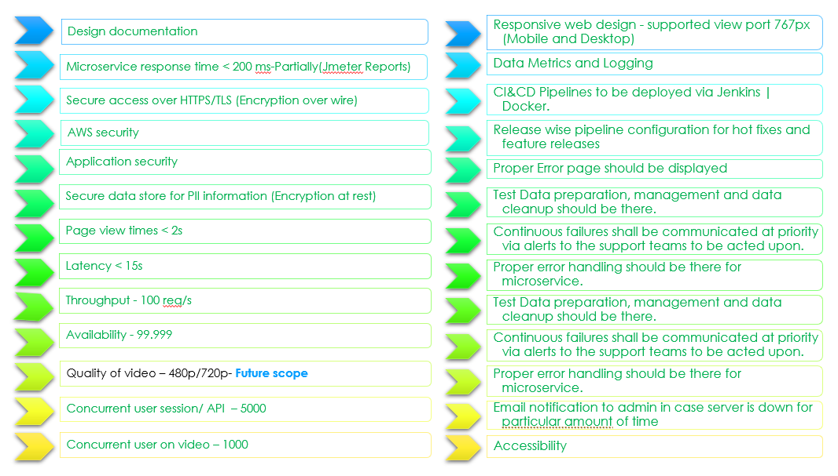
NFR and SLA
Notes:
Change arrow direction

Slide 6
Performance Testing
The primary objective of performance testing is to ensure how well a system performs in terms of speed, efficiency, and resource utilization, as well as to identify any bottlenecks, weaknesses, or limitations that may exist within the system during simulations of different user scenarios and loads.

Slide 7
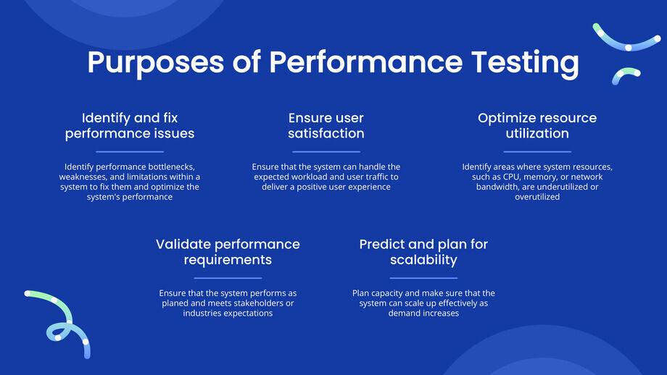
Performance Testing

Slide 8
Why Performance Testing
Performance Testing assesses how a system behaves under a particular workload, with goals to:
Validate Responsiveness: Ensure acceptable response times under expected loads.
Verify Stability: Detect memory leaks, resource bottlenecks, or failures under sustained usage.
Measure Scalability: Determine how well the system scales as load increases.
Prevent Regressions: Compare current performance against baselines to catch degradations early.

Slide 9
Why Performance Testing
Identify and fix performance issues.
Performance testing helps identify performance bottlenecks, weaknesses, and limitations within a system.
It enables the detection of any issues related to slow response times, high resource consumption, scalability limitations, or other performance-related problems during the simulation of real-world scenarios and loads.
Identifying these issues early allows developers to fix them and optimize the system's performance.

Slide 10
Why Performance Testing
Ensure user satisfaction.
Performance testing ensures that the system or application can handle the expected workload and user traffic without any performance degradation.
It helps to ensure a smooth user experience regarding testing under realistic conditions.
Users lose interest or patience if a system is slow or unresponsive, which leads to dissatisfaction and the potential loss of customers or users.
Performance testing helps avoid these risks and deliver a positive user experience.

Slide 11
Why Performance Testing
Predict and plan for scalability. Performance testing allows project teams to assess the scalability of a system.
It helps find out if the system can handle future growth without significant performance issues.
This information is a key to plan capacity and allocate resources, and to make sure that the system can scale up effectively as demand increases.

Slide 12
Why Performance Testing
Validate performance requirements.
Performance testing helps validate the specified performance requirements.
It provides objective data and metrics that can be compared against predefined performance targets.
This validation ensures that the system performs as planed and meets the expectations of the stakeholders or the industry.

Slide 13
Why Performance Testing
Optimize resource utilization.
Performance testing helps identify areas where system resources, such as CPU, memory, or network bandwidth, are under- or overutilized.
Knowing this, developers can optimize the system to use resources efficiently, save costs, and improve overall performance.

Slide 14
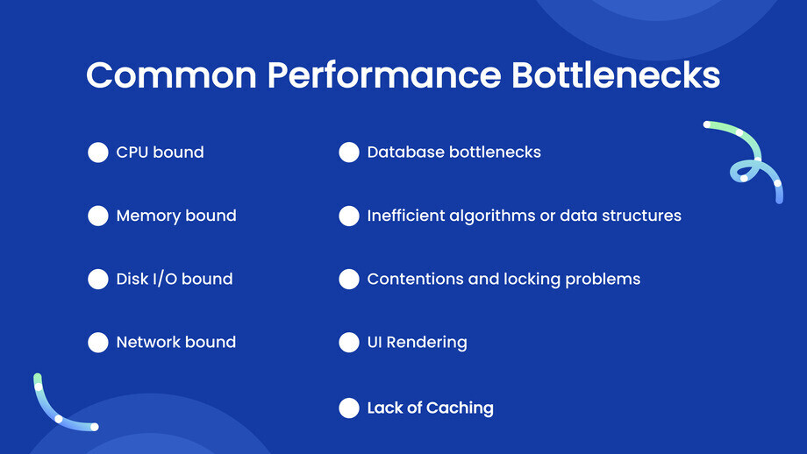
Common performance bottlenecks

Slide 15
Utilization
Utilization is the ratio of the throughput of the application relative to its maximum capacity.
This is a measure of how well the application is being used.
It is not desirable to operate above 80% utilization because the user requests do not arrive evenly, and the system should be able to handle a spike in the load.

Slide 16
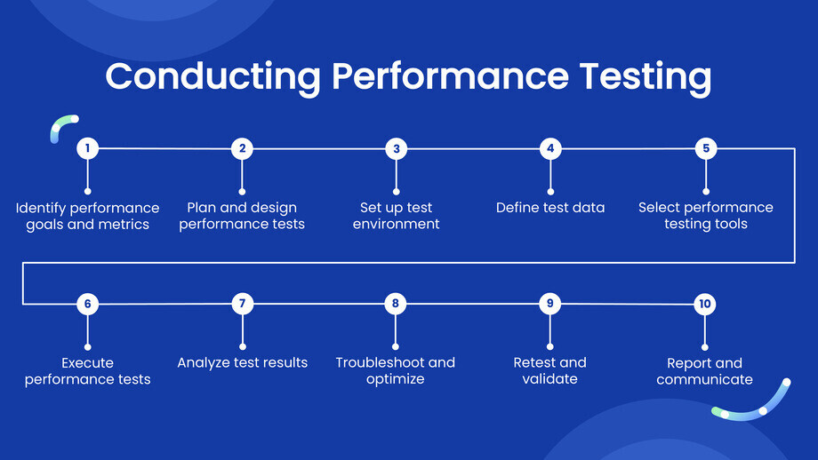
How to conduct Performance Testing

Slide 17
Typical Performance-Testing Process
Planning & Requirements
Define performance goals (SLAs)
: e.g., “95% of requests < 500 ms under 1,000 users.”
Identify key transactions (login, search, checkout).
Test Design
Model realistic user workflows and think times.
Determine test data and scripts.
Environment Setup
Mirror production (hardware, network topology, data volumes).
Ensure monitoring tools are in place (APM, OS metrics, DB stats).
Scripting & Parameterization
Develop test scripts (parameterize inputs, handle sessions).
Incorporate data feeders or dynamic data generation.

Slide 18
Typical Performance-Testing Process
Baseline & Dry Runs
Run small-scale tests to validate scripts and stabilize the environment.
Establish baseline performance.
Test Execution
Ramp up load per the plan (steady, spikes, stress).
Monitor system health and metrics in real time.
Analysis & Tuning
Correlate application logs, APM traces, and OS metrics.
Identify bottlenecks (CPU hotspots, DB slow queries, GC pauses).
Tune configuration, code, or infrastructure; then retest.
Reporting
Summarize findings: charts of response times vs. load, resource trends, SLA compliance.
Provide recommendations and action items.

Slide 19
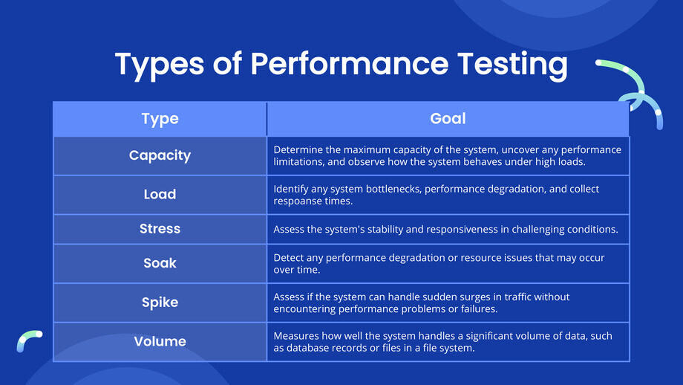
Performance Test Types

Slide 20
Performance Test Types
Capacity Testing checks how well the system can handle a specific workload or user load while maintaining good performance.
Its main goal is to determine the maximum capacity of the system, uncover any performance limitations, and observe how the system behaves under high loads.
It helps determine the system's ability to scale up or down to meet the performance requirements as the user load varies.

Slide 21
Performance Test Types
Load Testing entails testing the system with expected user loads to observe its behavior during normal and peak usage.
It helps identify any system bottlenecks or performance degradation and allows the collection of response times.

Slide 22
Performance Test Types
Stress Tests
A stress test is a kind of performance test that tests the application beyond the normal limits.
The application is subjected to excess load and after that its stability and performance are noted.
This type of test is used to determine how the application responds to load spikes.

Slide 23
Performance Test Types
Peak Load Tests
A peak load test is performed at the load that the application is expected to handle. For example, e-commerce web sites experience their peak traffic during Black Friday, Cyber Monday, and the Christmas holidays.
So, a peak load test in this case would test the application within the load specification but at the higher end.

Slide 24
Performance Test Types
Soak Tests or Endurance Tests
In a soak test (also called an endurance test), the application is subjected to a specified load that is within the specified limit but for a long duration.
It is performed for many hours at a time.
This test determines if the application is properly reusing its resources.
This test will surface problems like the following:
• Memory leaks in the application
• Database connections exhaustion
• Network connection exhaustion
• Log files becoming full and log rotation
• Other resource exhaustion

Slide 25
Performance Test Types
Spike Testing analyzes how the system responds to sudden and substantial increases under user load.
Its purpose is to assess if the system can handle sudden surges in traffic without encountering performance problems or failures.

Slide 26
Performance Test Types
Volume Testing evaluates the system's performance by testing it with a large amount of data.
It measures how well the system handles a significant volume of data, such as database records or files in a file system.

Slide 27
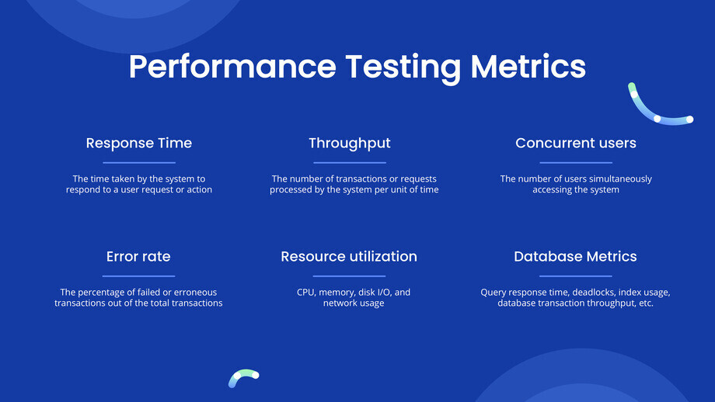
Performance Testing Metrics

Slide 28
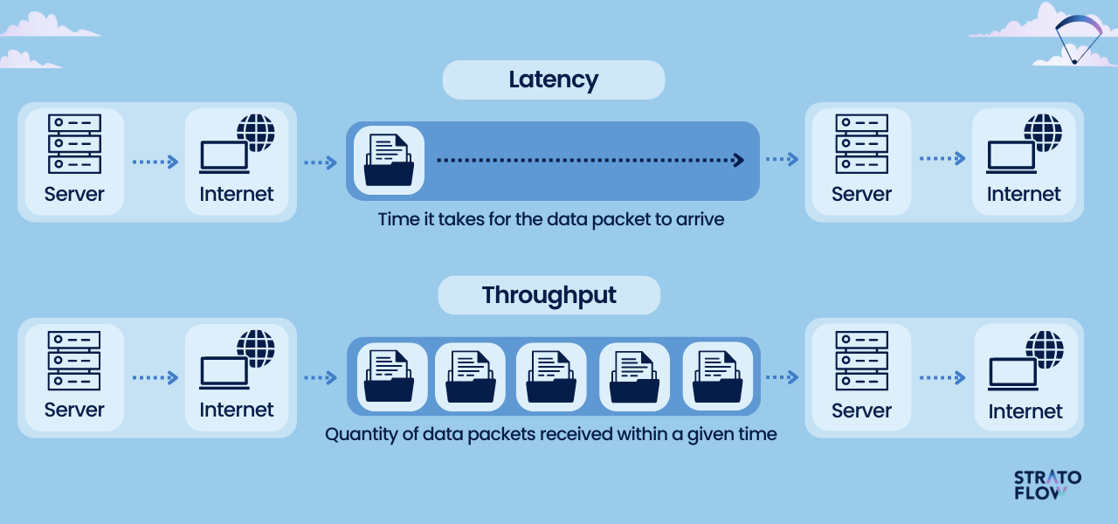
Performance Testing Metrics

Slide 29
Response Time
The time taken by the application to respond to the user’s request is called the response time.
It is measured in seconds or milliseconds as appropriate for the application.
Every application should strive to minimize the response time.

Slide 30
Response Time
Absolute Response Time: This is the total time taken from the instant a user clicks on a link or submits a form until the response from the server is rendered completely.
Server Processing Time: This is the time taken by the server to process the given input and generate the output. This can vary depending on the complexity of the request, server hardware, and the system load.

Slide 31
Response Time
Rendering Time: This is the time taken by the browser to parse and render the response received from the server.
This depends on the complexity of the web page, presence of multimedia, presence of JavaScript, and whether the browser needs to generate content.
It also depends on the system load on the user’s device.

Slide 32
Response Time
Network Latency: This is the round-trip time taken by a data packet to travel over the network the server and back.
This does not include the server processing time or the rendering time.
This can vary widely depending on the location of the user, time of the day, and the network load.

Slide 33
Throughput
A sequence of request/responses constitutes a transaction.
The number of transactions per unit time is called the throughput.
It is measured in transactions/second or bandwidth (bytes/second).
It depends on server hardware, system load, and network latency.
The application should strive to maximize the throughput.

Slide 34
Robustness
This is a measure of how well the application detects and handles various errors and exceptions.
If the system crashes or becomes unavailable, the company’s brand and reputation are at stake.
Mean Time between Failures (MTbF) is a metric that is often used for this purpose.

Slide 35
Scalability
Scalability measures how well the system can expand its capacity when additional resources are added.
Ideally the system capacity will increase linearly as additional resources are added.
However, this is rarely achieved in practice. It’s a good measure to know the resources that would be needed so that the system can handle the projected future load.
Vertical scalability is achieved by upgrading the hardware. For example, by adding more memory, disk, a better CPU, or additional CPUs.
Horizontal scalability is achieved by adding servers to the cluster. For example, by adding more web servers and application servers to a webfarm/cluster.

Slide 36
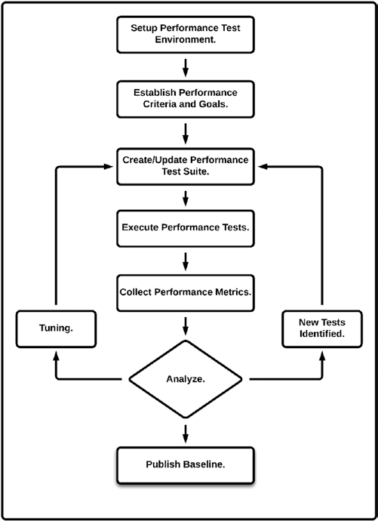
Performance Tuning

Slide 37
Best Practices
Start performance testing early in the development cycle.
Define clear performance goals and requirements.
Use realistic test scenarios and workload models.
Test with production-like test environments and data.
Monitor system resources during testing.
Conduct iterative testing and analysis for continuous improvements.
Collaborate with developers and stakeholders to address performance issues.
Perform regular performance regression testing to ensure continued performance.
Document and communicate performance testing results and recommendations.

Slide 38
Why to use a performance Testing tools
Realistic Load Generation
Scale to hundreds or thousands of users:
Tools can simulate virtual users from multiple machines, mimicking real-world concurrency.
Control over load patterns:
Ramp-up, steady-state, spikes, and stress scenarios are easy to define and execute reproducibly.
Accurate, Consistent Metrics
Built-in instrumentation:
Capture response times (average, percentiles), throughput (RPS/TPS), and error rates without custom coding.
Resource monitoring integrations:
Many tools integrate with APMs (New Relic, Dynatrace), system-metrics (CPU, memory), and network monitors to correlate load and system health.

Slide 39
Why to use a performance Testing tools
Scripting & Parameterization
Reusable test scripts:
Define user journeys in code or DSL (e.g., Gatling’s Scala DSL, k6’s JavaScript) for easy maintenance.
Dynamic data feeds:
Parameterize inputs (login credentials, search terms) so tests exercise the system realistically rather than replaying identical transactions.
Automation & CI/CD Integration
Catch regressions early:
Embedded performance tests in pipelines (Jenkins, GitLab CI, GitHub Actions) ensure new code doesn’t introduce slow-downs.
Scheduled runs: Automatically execute nightly or weekly to track trends and spot degradations before they reach production.

Slide 40
Why to use a performance Testing tools
Bottleneck Identification & Analysis
Detailed reporting: Generate charts (response time vs. load, resource utilization over time), log failures, and highlight outliers.
Correlation of layers: Link application logs, database slow-queries, and garbage-collection pauses directly to test phases.
Reproducibility & Auditability
Version-controlled scripts and configurations:
Every test run is traceable back to a specific code or config version.
Repeatable environments:
Docker containers or cloud-based test agents (e.g., BlazeMeter) let you re-run tests with identical topology.

Slide 41
Why to use a performance Testing tools
Cost and Risk Reduction
Prevent outages:
Identifying capacity limits ahead of time avoids unpleasant surprises when real traffic spikes occur.
Optimize resource usage:
Right-size infrastructure by knowing precisely how many nodes or CPU cores you need under peak load.
Standardization & Best Practices
Community-driven plugins and extensions:
Extend core capabilities (e.g., JMeter plugins for WebSockets, JMS, database connection pooling).
Built-in assertions and thresholds:
Fail builds or alert teams automatically if SLAs (e.g., P95 < 500 ms) aren’t met.

Slide 42
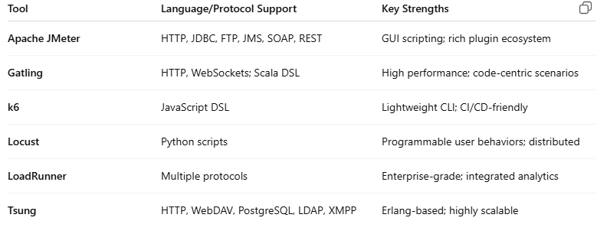
Popular Performance-Testing Tools

Slide 43
JMeter
Apache JMeter is an open-source, pure Java application designed for load and performance testing.
Initially developed to test web applications, it has grown into a versatile tool that can simulate heavy loads on a variety of protocols.

Slide 44
Key Features
Protocol Support
HTTP, HTTPS (web)
SOAP / REST web services
JDBC (database via JDBC driver)
JMS (Java Message Service)
FTP, SMTP/POP3/IMAP (mail servers)
TCP, and more via plugins

Slide 45
Key Features
Extensible Architecture
Plugins:
Hundreds available (e.g., WebSocket, MongoDB)
Scripting:
Groovy, BeanShell, JavaScript for custom logic
Listeners:
Custom result processors and reporters
GUI & CLI Modes
GUI: Drag-and-drop test plan creation, real-time graphs
Non-GUI (CLI): Headless test execution for CI/CD and load generators

Slide 46
Key Features
Distributed Testing
Master-slave setup lets you scale out load generation across multiple machines
Assertions & Correlations
Validate response content, duration, size
Extract data from responses (e.g., session IDs) for parameterization

Slide 47
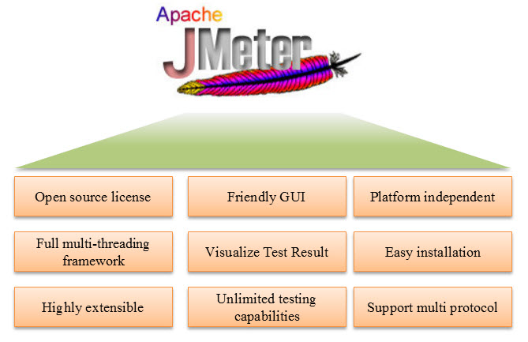
Advantages

Slide 48
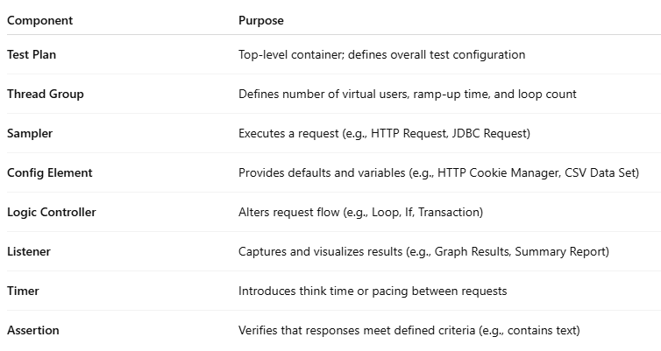
Core Components

Slide 49
Typical Usage Workflow
Design
Create a Test Plan
Add Thread Groups and configure user load
Configure Samplers, Timers, Assertions, and Listeners
Parameterize
Use CSV Data Set Config or JDBC Pre-Processor to drive dynamic data
Dry-Run
Validate correctness in GUI mode with a small number of threads

Slide 50
Typical Usage Workflow
Scale Out
Switch to non-GUI mode for full-scale runs
Optionally configure distributed (master/slave) execution
Monitor & Analyze
Correlate JMeter results with APM and OS metrics
Identify bottlenecks via throughput vs. response-time graphs
Report
Export HTML dashboards or CSVs for deeper analysis
Compare against SLAs and baselines

Slide 51
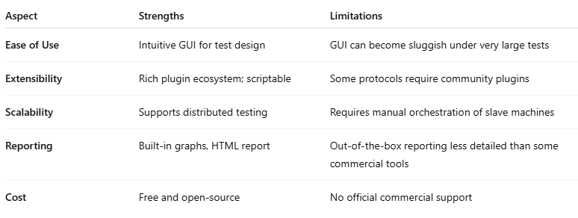
Strengths and Limitations

Slide 52
When to Choose JMeter
You need a cost-effective, community-driven solution.
Your focus is on web-based applications, REST/SOAP services, or database performance.
You want to integrate performance tests into your CI/CD pipeline (via CLI).
You need extensible scripting capabilities for custom workflows.

Slide 53
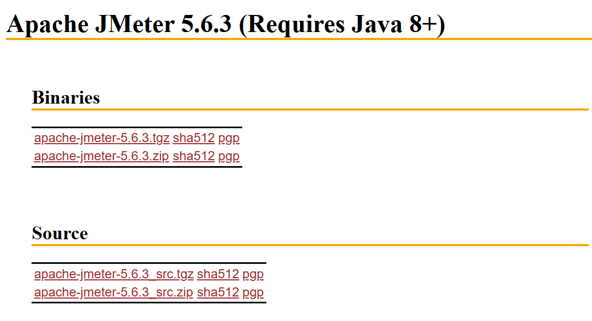
Download Jmeter

Slide 54
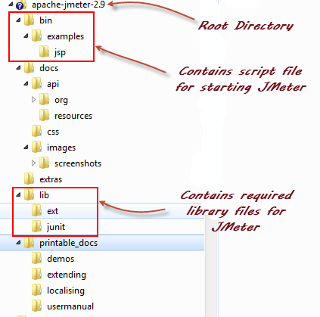
Installation

Slide 55
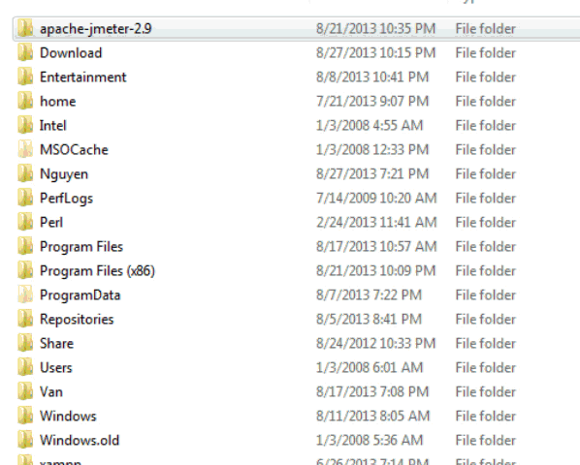
Start JMeter in GUI Mode

Slide 56
Classpath-Loading Order
When you run JMeter (via jmeter/jmeter.sh or the Windows .bat), the script builds the runtime classpath in this sequence:
JMeter bootstrap JAR
The launcher itself (ApacheJMeter.jar) is first on the classpath.
<JMETER_HOME>/lib/*.jar
All libraries under lib/—general dependencies, JDBC drivers, JSON parsers, etc.
<JMETER_HOME>/lib/ext/*.jar
JMeter components and plugins: samplers, listeners, pre- and post-processors, functions.

Slide 57
Classpath-Loading Order
Paths from JMeter properties
user.classpath defines extra jars or folders.
plugin_dependency_paths for plugin-specific libs.
search_paths can point to alternate plugin locations.
Java extension directory
If you’ve dropped JARs in your JRE’s lib/ext, they’ll be loaded by the extension class loader.

Slide 58
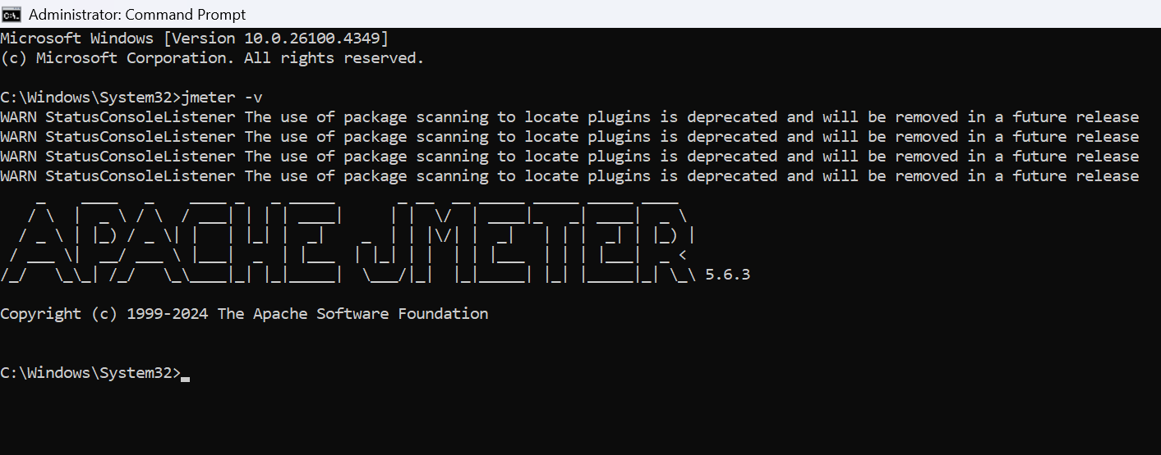
Jmeter CLI

Slide 59
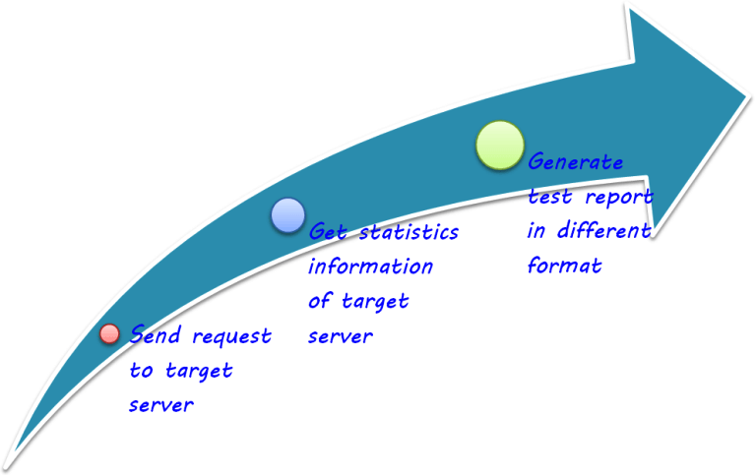
How does JMeter work ?

Slide 60
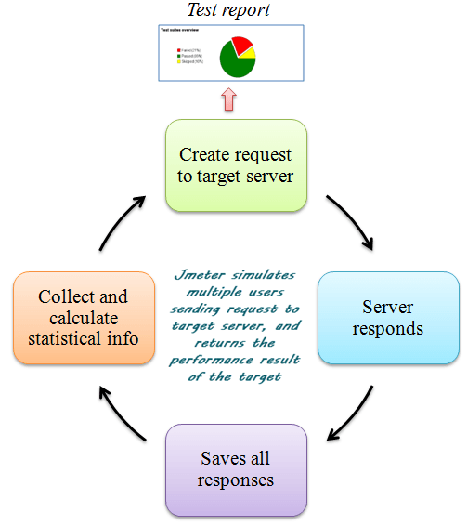
How does JMeter work ?

Slide 61
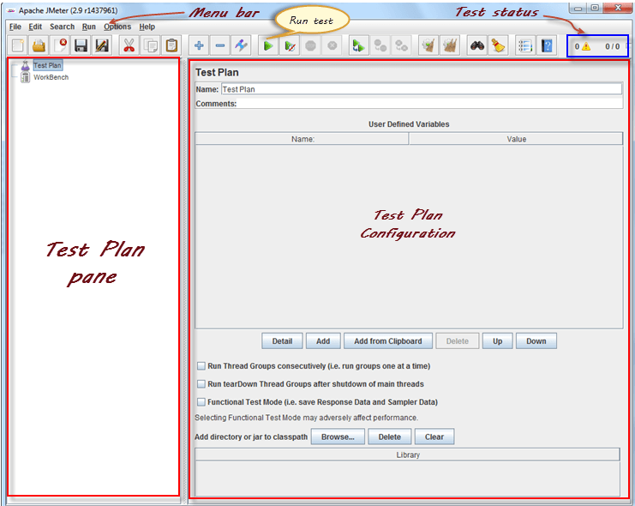
Start JMeter in GUI Mode

Slide 62

Understanding JMeter_HOME
Definition of JMeter_HOME
JMeter_HOME refers to the directory path where Apache JMeter is installed on your system.
Contents of JMeter_HOME
The JMeter_HOME folder contains essential files and subdirectories, including bin, docs, extras, and lib.
Importance of JMeter_HOME Variable
Setting the JMeter_HOME environment variable ensures smooth operation and resource location during performance testing.
JMeter_HOME as Jmeter folder path
Notes:
JMeter_HOME refers to the directory path where Apache JMeter is installed on your system. This folder contains all the essential files and subdirectories needed to run JMeter, including bin, docs, extras, and lib. Setting the JMeter_HOME environment variable correctly ensures smooth operation and allows JMeter to locate necessary resources during performance testing.

Slide 63
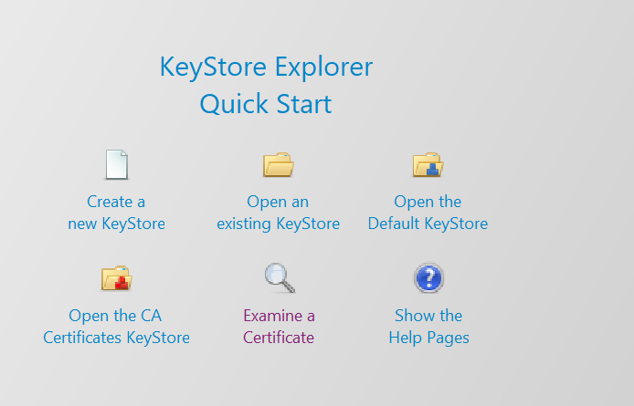
Generate Key Pair
Install Keystore Explorer

Slide 64
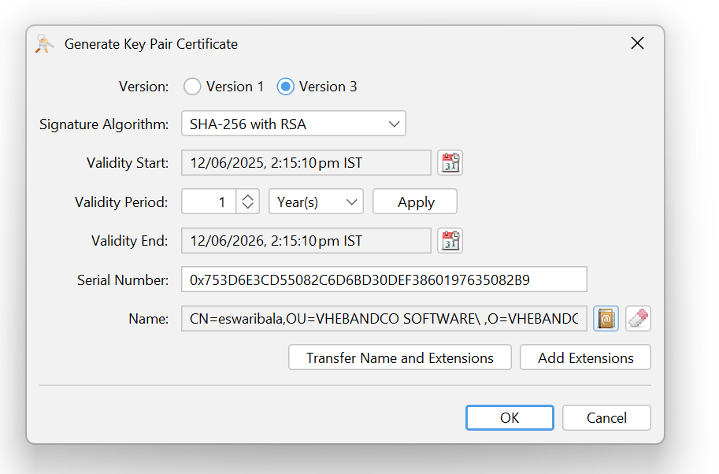
Generate Key Pair
Install Keystore Explorer

Slide 65
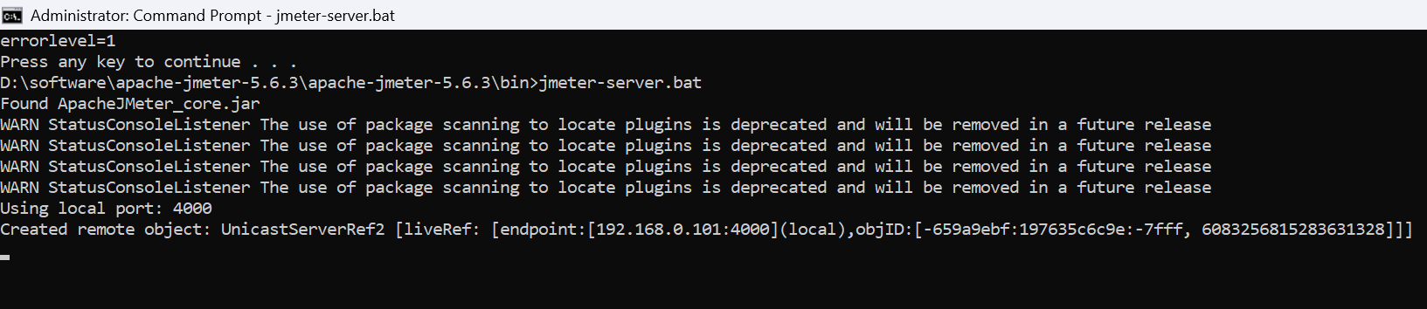
Start JMeter in Server Mode

Slide 66
Non-GUI Mode
Non-GUI mode is recommended as a test execution mode in JMeter.
The reason is that JMeter consumes less memory in Non-GUI mode which helps to accommodate more threads on a load generator.
Non-GUI mode provides more space for threads and prevents the failure of the test due to out of memory issue.
Running Apache JMeter in non-GUI mode is essential for performance testing in real environments (CI/CD, headless servers, or automation).

Slide 67
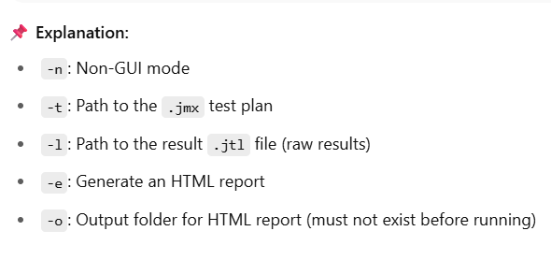
Non-GUI Mode
For Windows:
Go to “Start”
Search “Run” Or Press “Win+r”
Navigate to ‘bin’ folder of JMeter using “cd” command
Type the command:
jmeter -n -t <jmx file name with path> -l <log file name with path>

Slide 68
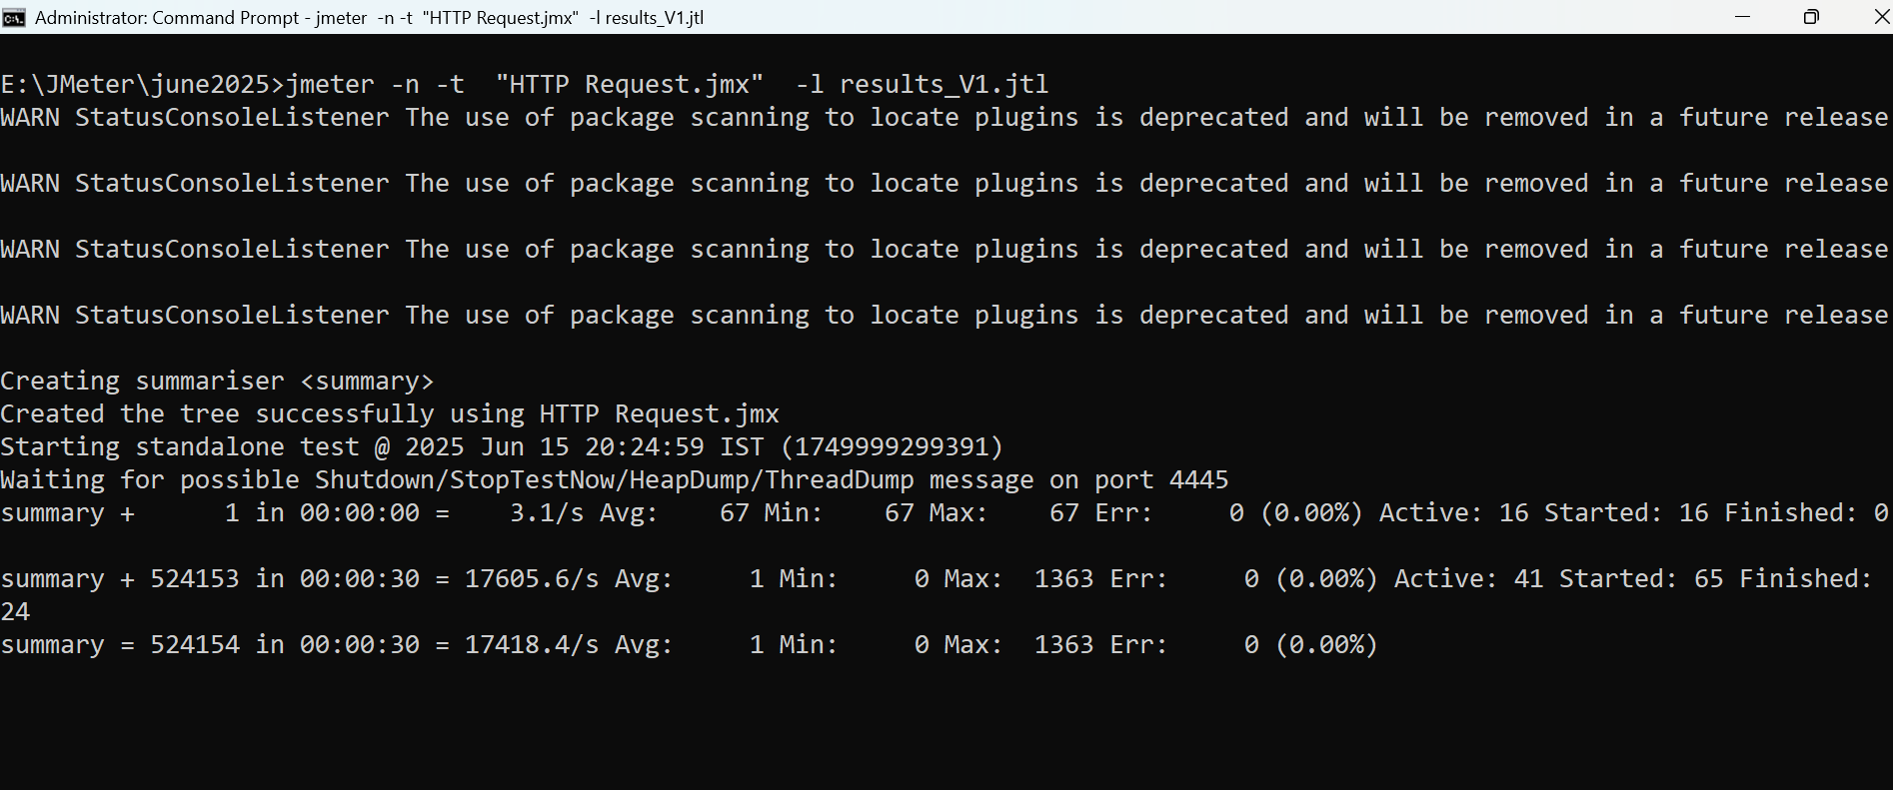
Non-GUI Mode - To create .jtl file

Slide 69
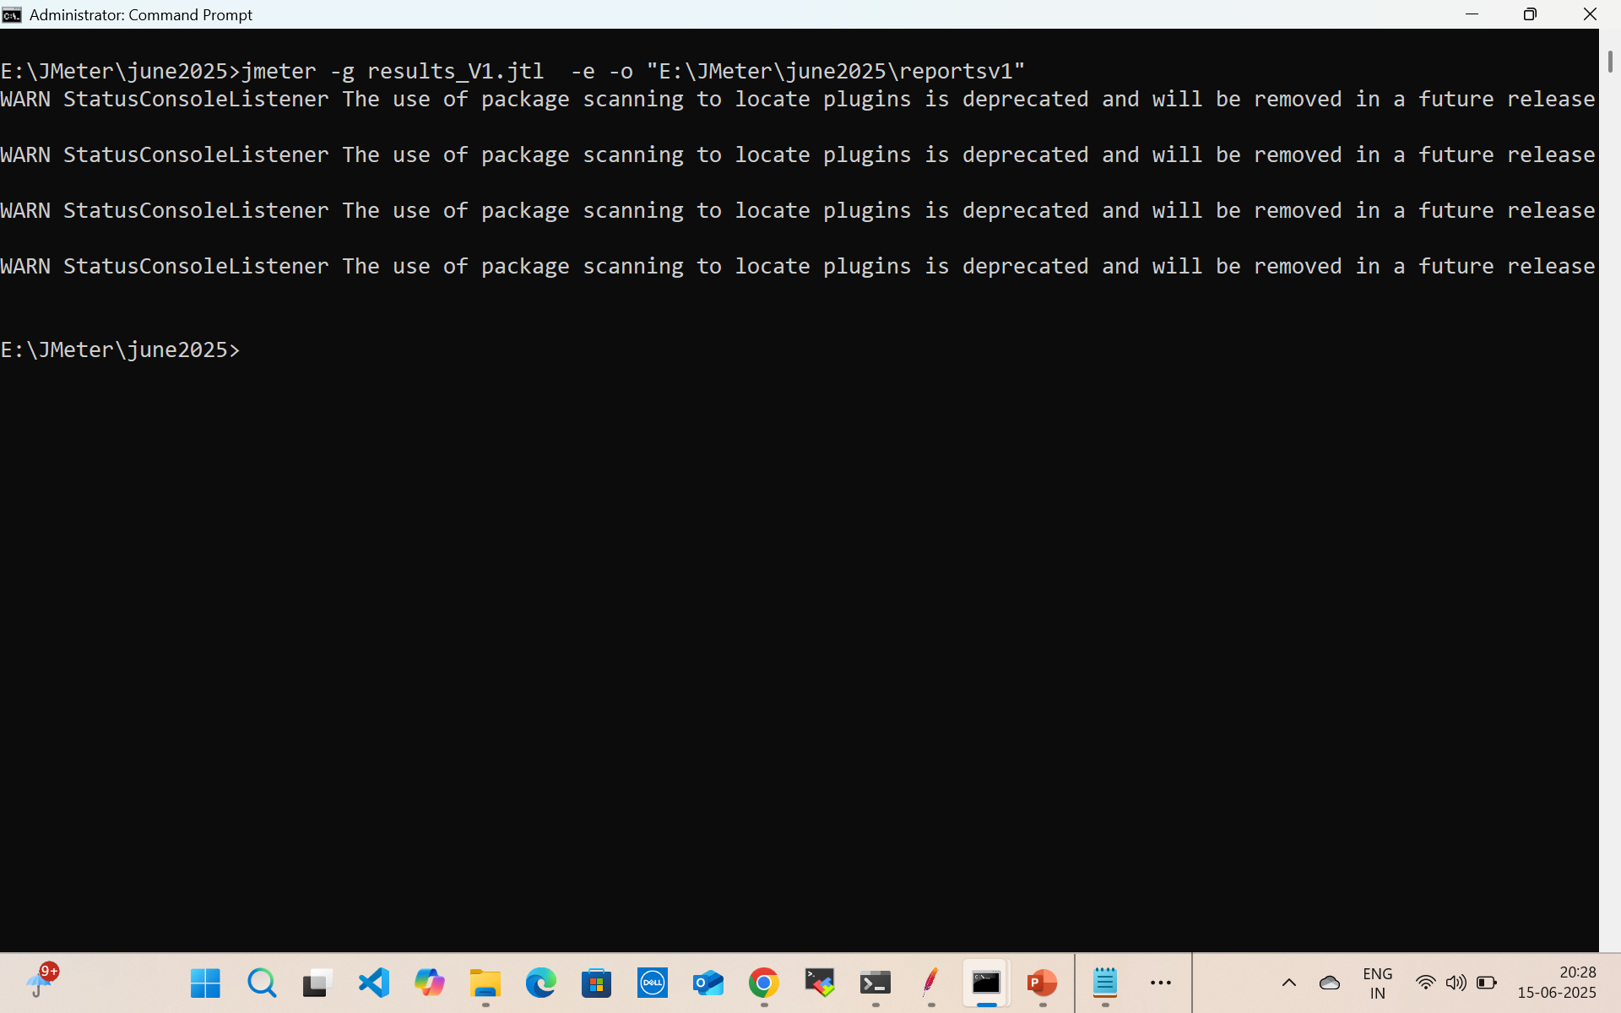
Non-GUI Mode - Generate .html file

Slide 70
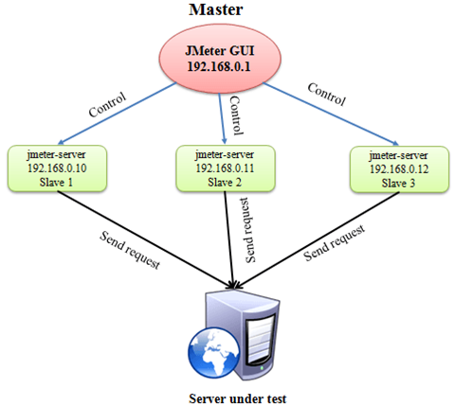
Jmeter Distributed Mode

Slide 71
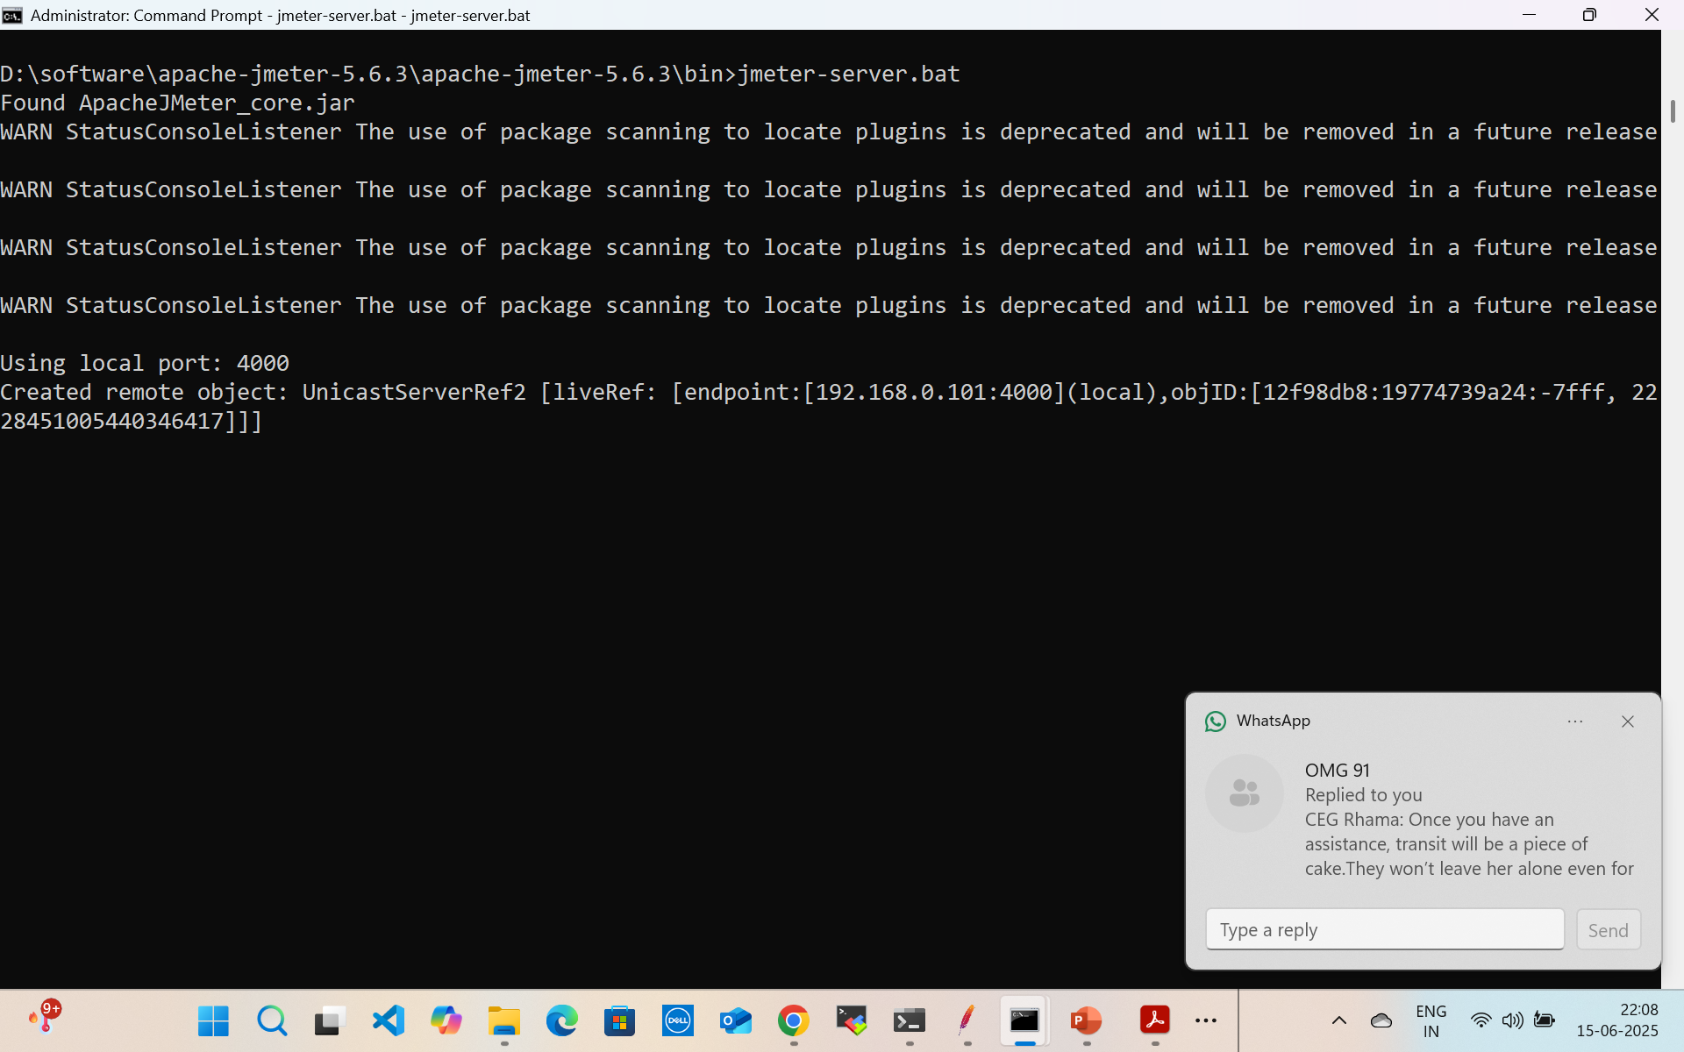
Jmeter Distributed Mode

Slide 72
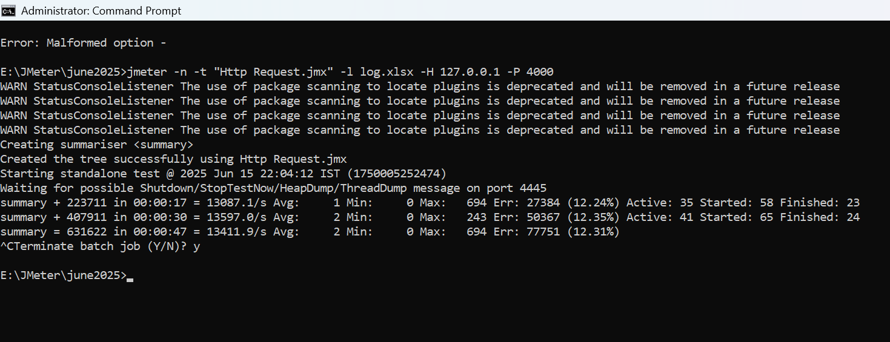
Jmeter Distributed Mode

Slide 73
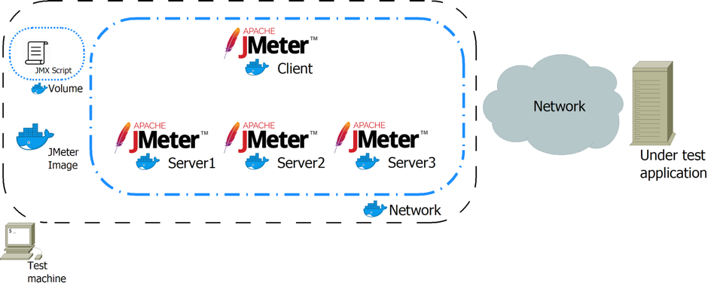
JMeter Distributed Mode

Slide 74
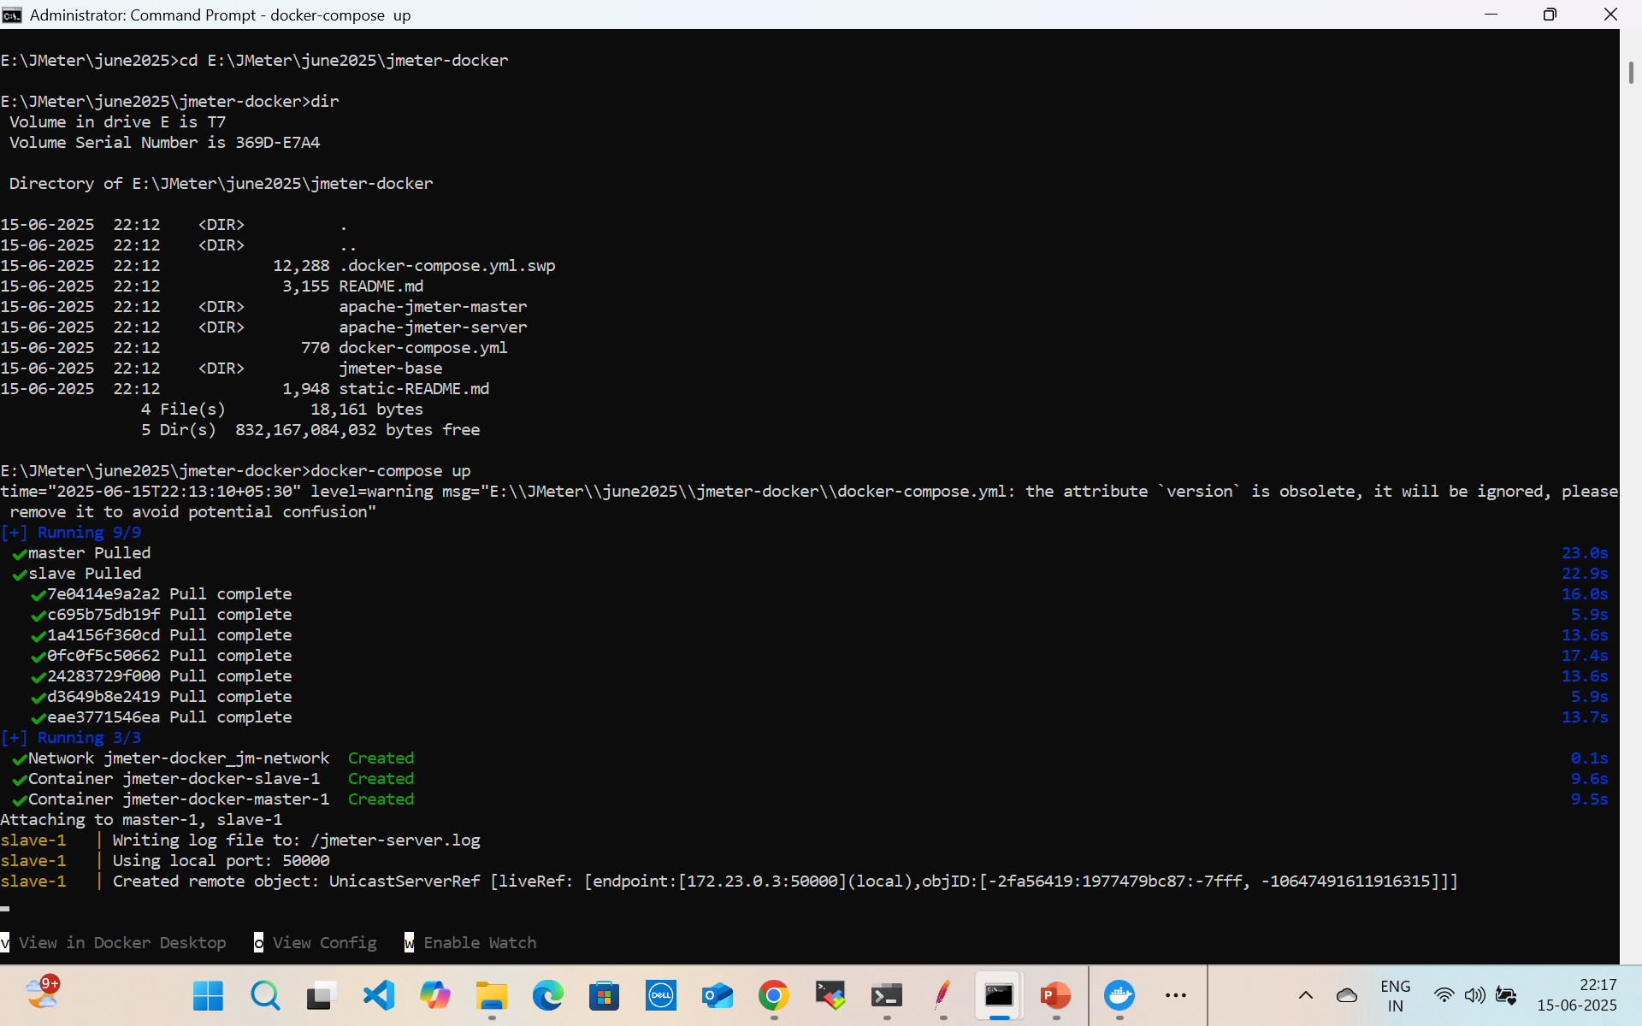
JMeter Distributed Mode

Slide 75
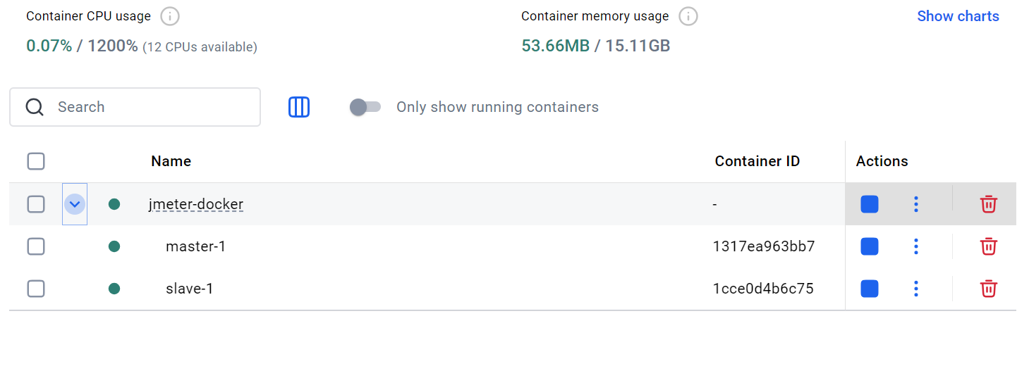
JMeter Distributed Mode

Slide 76
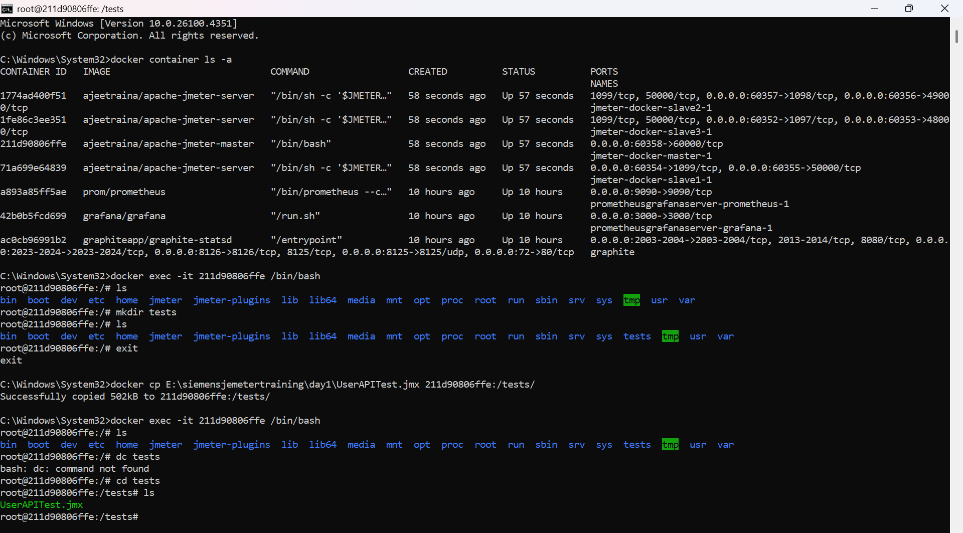
JMeter Distributed Mode

Slide 77
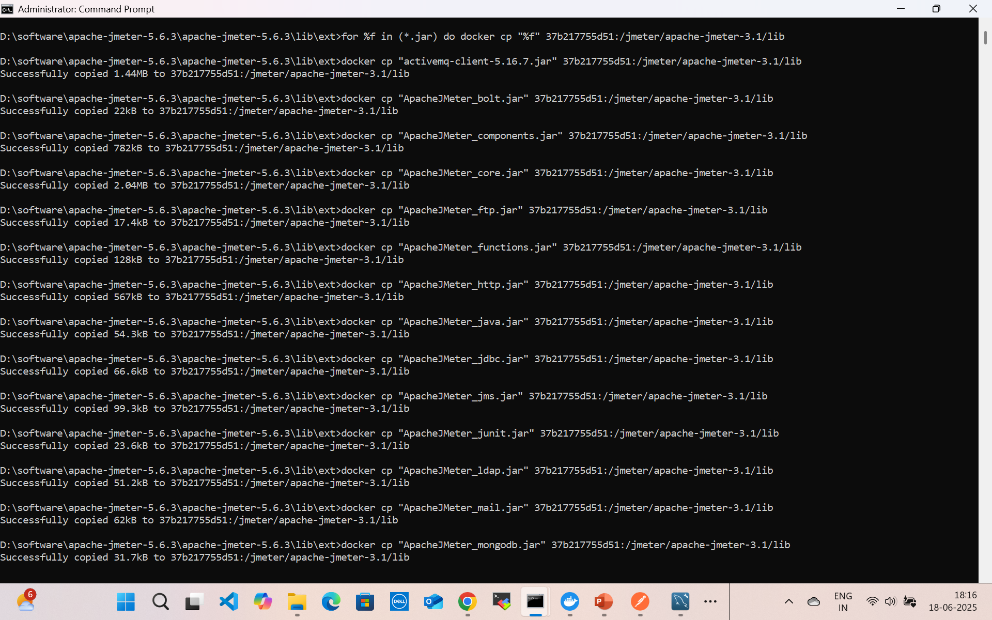
JMeter Distributed Mode only for STG or UTG
for %f in (*.jar) do docker cp "%f" 37b217755d51:/jmeter/apache-jmeter-3.1/lib

Slide 78
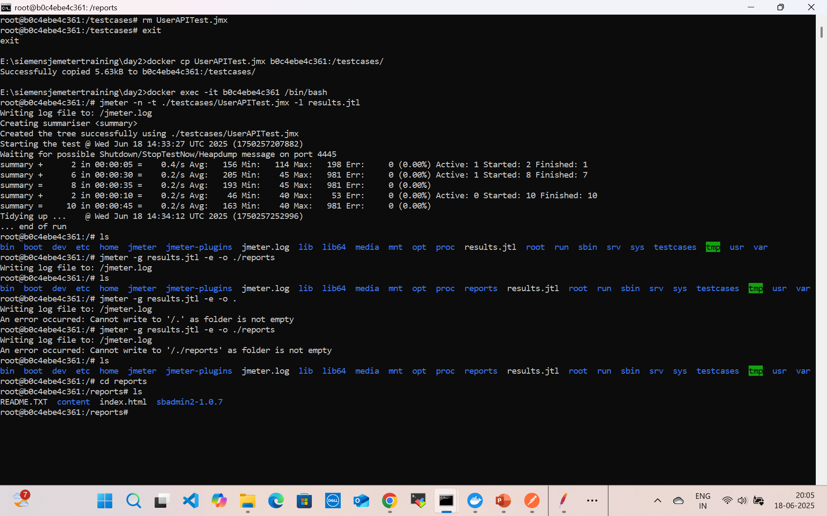
JMeter Distributed Mode

Slide 79
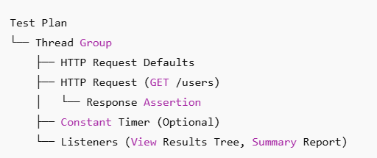
Overview of a Test Plan
A Test Plan is the container for all testing components in JMeter. It defines:
What to test
How to test (scenarios, requests)
How much to test (load, concurrency)
How to validate the test (assertions)
How to record/report results (listeners)

Slide 80
Test Plan Steps
Step 1: Add a Test Plan
Open JMeterRight-click on the Test Plan
Rename to something meaningful (e.g., User Login Load Test)

Slide 81
Test Plan Steps
Step 2: Add Thread Group
Right-click Test Plan → Add → Threads (Users) → Thread Group
Configure:
Number of Threads (Users): e.g., 10
Ramp-Up Period (sec): e.g., 5
Loop Count: e.g., 10

Slide 82
Test Plan Steps
Step 3: Add HTTP Request Defaults (optional)
Right-click Thread Group → Add → Config Element → HTTP Request Defaults
Set:
Server Name or IP: jsonplaceholder.typicode.com
Protocol: https
This avoids repeating host in every request

Slide 83
Test Plan Steps
Step 4: Add HTTP Sampler (e.g., GET Users)
Right-click Thread Group → Add → Sampler → HTTP Request
Name: Get Users
Set:
Method: GET
Path: /users

Slide 84
Test Plan Steps
Step 5: Add Response AssertionRight-click HTTP Request → Add → Assertions → Response Assertion
Check Response Data
Add pattern like: "username": "Bret"

Slide 85
Test Plan Steps
Step 6: Add Listeners
These display results.
Add Listener → View Results Tree
Add Listener → Summary Report
Add Listener → Aggregate Report

Slide 86
JMeter Thread Group
In Apache JMeter, a Thread Group is your “load generator”—it defines how many virtual users (threads) to simulate, how quickly they start, and how many times they execute the test plan.
Every test plan must contain at least one Thread Group.

Slide 87
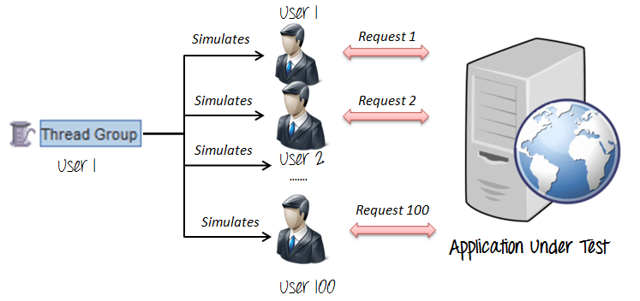
Thread Group
Every test has one or more thread groups.
A thread group is a child element of a test plan.
Each thread group represents a use-case.
A thread group can be configured with the number of threads, ramp-up time, and other useful properties that allow you to control its behavior.

Slide 88

JMeter Thread Group
Defining Threads
A JMeter Thread Group defines the number of threads, simulating virtual users for load testing.
Ramp-Up Period
Ramp-up period allows users to gradually increase the load over time, simulating real-world usage patterns.
Distributed Load
Thread Group settings determine how the load is distributed over time, which is crucial for accurate performance testing.
Notes:
A JMeter Thread Group is a crucial element that defines the number of threads (virtual users) and the ramp-up period for a test. It allows users to simulate multiple users hitting the server at the same time. Each thread represents an independent user performing requests to the server. The Thread Group setting helps in determining how the load is distributed over time.

Slide 89

Key Thread Group Settings
Simulating Multiple Users
Thread group settings enable testers to simulate multiple users accessing the application simultaneously, crucial for performance testing.
Controlling Thread Count
Adjusting the number of threads in a thread group helps testers control the load applied to the application during testing.
Setting Ramp-up Periods
Ramp-up periods allow testers to gradually increase the load on the application, preventing sudden spikes and ensuring accurate testing results.
Defining Loop Counts
Loop counts determine how many times a test will be executed, aiding in assessing application stability over prolonged usage.
Notes:
Key Thread Group Settings are essential in performance testing tools like JMeter. These settings allow testers to simulate multiple users, control the number of threads, set ramp-up periods, and define loop counts. Proper configuration of thread groups helps in accurately measuring the performance and stability of applications under various load conditions.

Slide 90
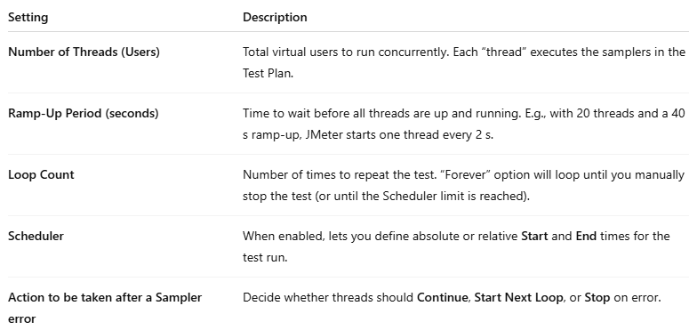
Key Thread Group Settings

Slide 91
Example Configuration
Add a Thread Group
Right-click on Test Plan → Add → Threads (Users) → Thread Group.
Configure Threads & Ramp-Up
Threads: 50
Ramp-Up: 100 seconds
Starts one thread every 2 s until all 50 are active.
Set Loops or Duration
Loop Count: 10
Each thread will execute the samplers 10 times (total of 500 sampler executions).
Or, enable Scheduler and specify Duration, e.g.:
Duration (seconds): 600 (10 minutes)
Error Handling
On error: set to “Continue” if you want the test to keep running even when individual requests fail.

Slide 92
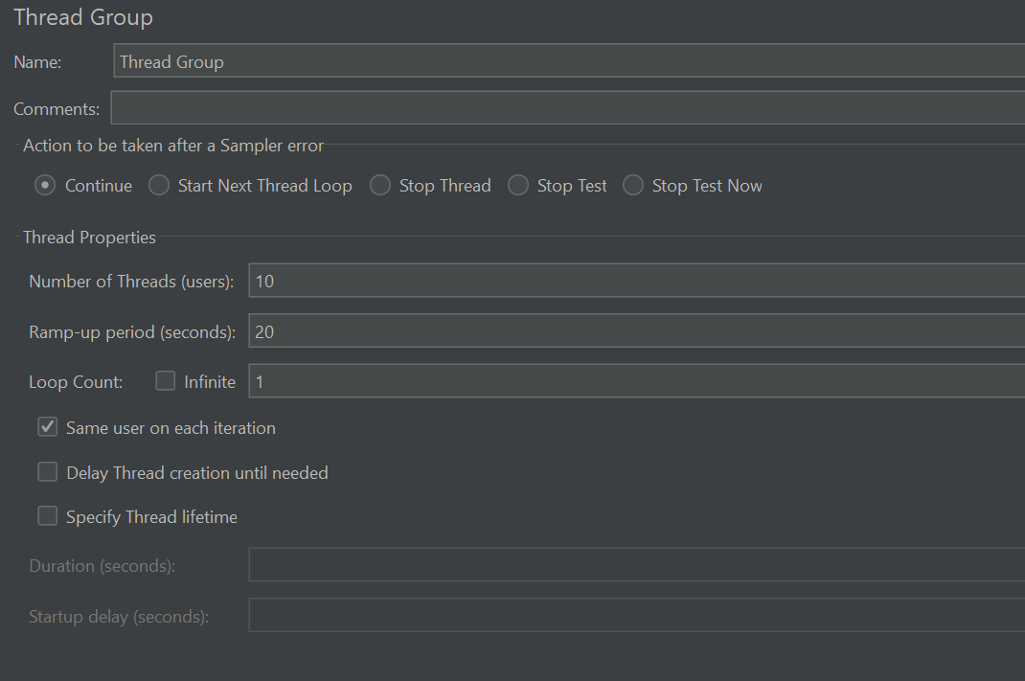



Example Configuration

Slide 93
Use Cases for Standard Thread Group in JMeter
1. Basic Load Testing
Objective: Measure how an application performs under a constant number of users.
Use Case:
50 users hitting an e-commerce product page simultaneously.
Measure average response time, throughput, and errors.
Why Standard Thread Group:
Fixed number of threads and ramp-up.
Simulates a steady load pattern.

Slide 94
Use Cases for Standard Thread Group in JMeter
2. Peak Load Simulation
Objective: Evaluate system behavior at high traffic volumes (stress testing).
Use Case:
Simulate 1,000 users performing checkout simultaneously.
Why Use It:
Helps find the breaking point of your system under pressure.

Slide 95
Use Cases for Standard Thread Group in JMeter
3. Soak Testing (Endurance Testing)
Objective: Run the test for an extended duration to check for memory leaks or performance degradation.
Use Case:
Run 100 users continuously for 6 hours against a search API.
Why Use It:
Standard Thread Group supports long duration execution with looping.

Slide 96
Use Cases for Standard Thread Group in JMeter
4. Functional Testing of APIs
Objective: Validate correctness of API responses under a small load.
Use Case:
10 virtual users calling REST APIs to validate status codes, JSON content, etc.
Why Use It:
Simplifies test setup for functional and regression tests.

Slide 97
Use Cases for Standard Thread Group in JMeter
5. Comparative Backend Analysis
Objective: Compare response times between two versions of a backend service.
Use Case:
Simultaneously hit v1 and v2 endpoints of a microservice.
Why Use It:
Use multiple Thread Groups for isolated, parallel execution.

Slide 98
Use Cases for Standard Thread Group in JMeter
6. Load Testing CI/CD Integration
Objective: Automate performance regression checks in pipelines.
Use Case:
As part of GitHub Actions, run 25 threads for 2 mins on each code push.
Why Use It:
Easy to configure and parameterize with environment variables and profiles.

Slide 99
Use Cases for Standard Thread Group in JMeter
7. Database Load Testing
Objective: Test DB query execution and locking behavior.
Use Case:
100 threads executing SQL queries to test a PostgreSQL database.
Why Use It:
Supports JDBC Samplers and timed execution.

Slide 100
Advanced Thread Group Types
Beyond the standard Thread Group, JMeter plug-ins offer more sophisticated load patterns:
Stepping Thread Group Gradually increases threads in steps (e.g., +10 every minute).
Ultimate Thread Group Allows you to schedule different start/stop intervals for multiple user groups within one element.
Concurrency Thread Group Maintains a target concurrency level; new threads are spun up as others finish.

Slide 101
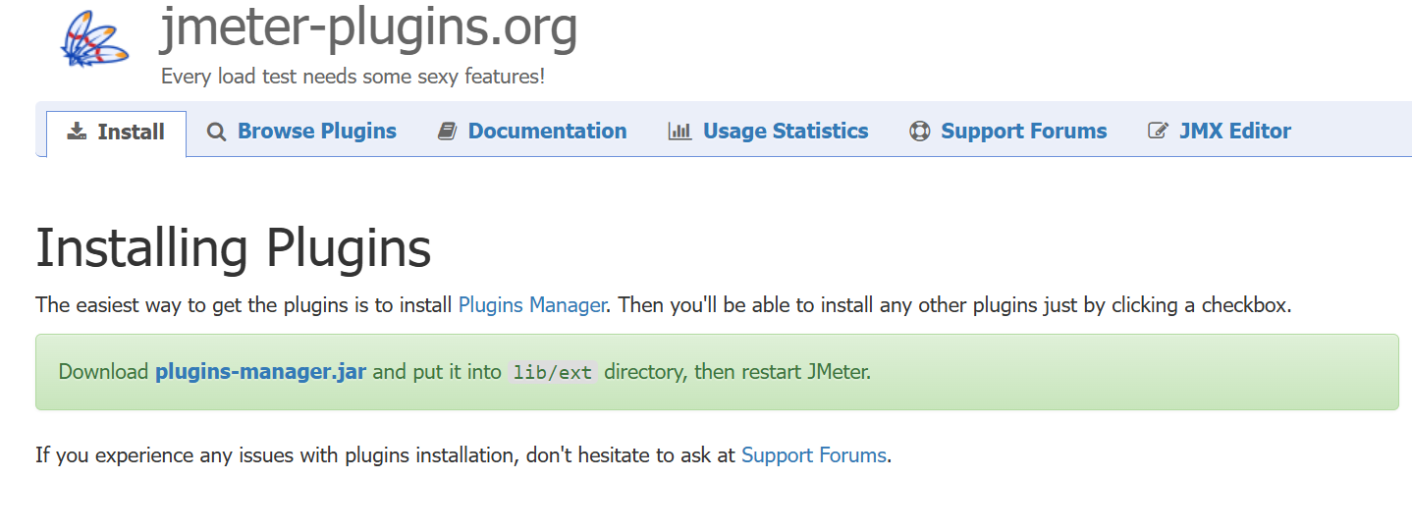

Stepping Thread Group
https://jmeter-plugins.org/install/Install/

Slide 102
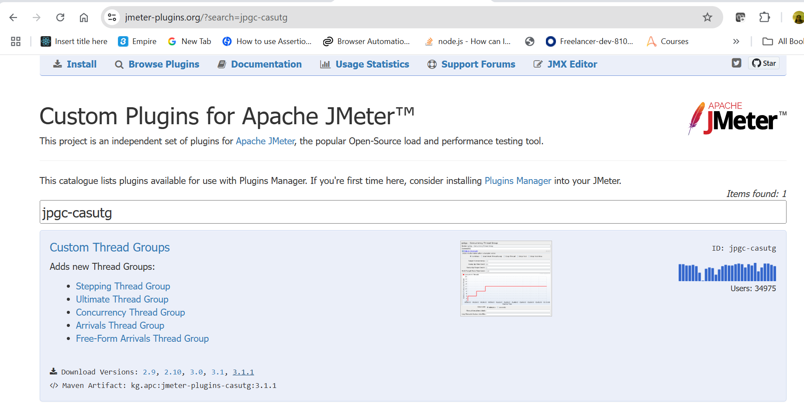

Stepping Thread Group

Slide 103
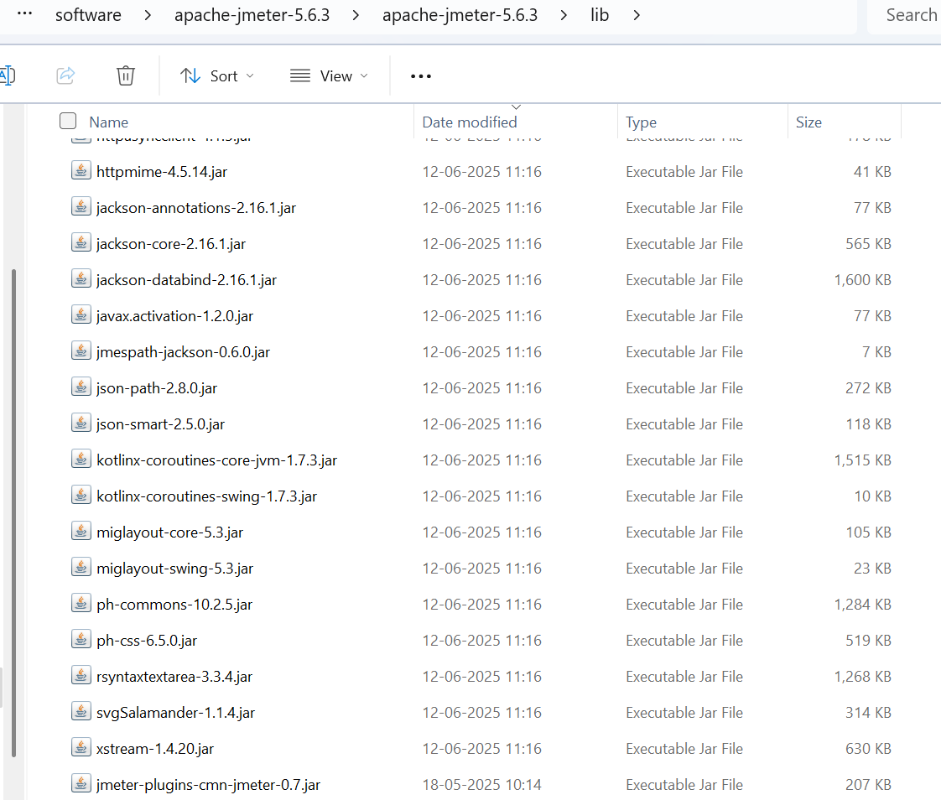
Stepping Thread Group
JMeter installation lib folder

Slide 104
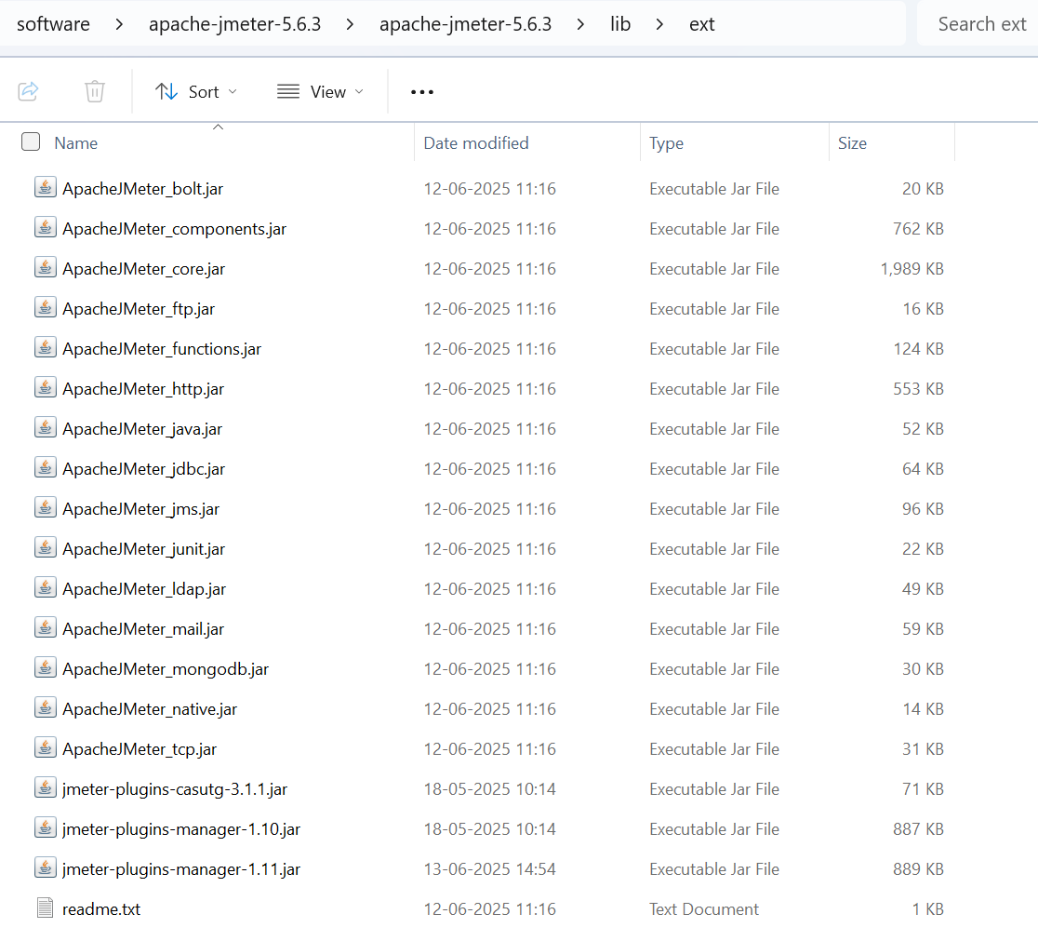

Stepping Thread Group
JMeter installation lib/ext folder

Slide 105
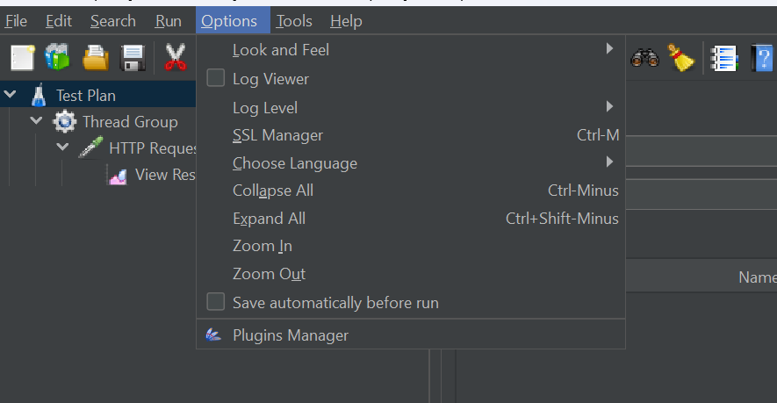

Stepping Thread Group

Slide 106
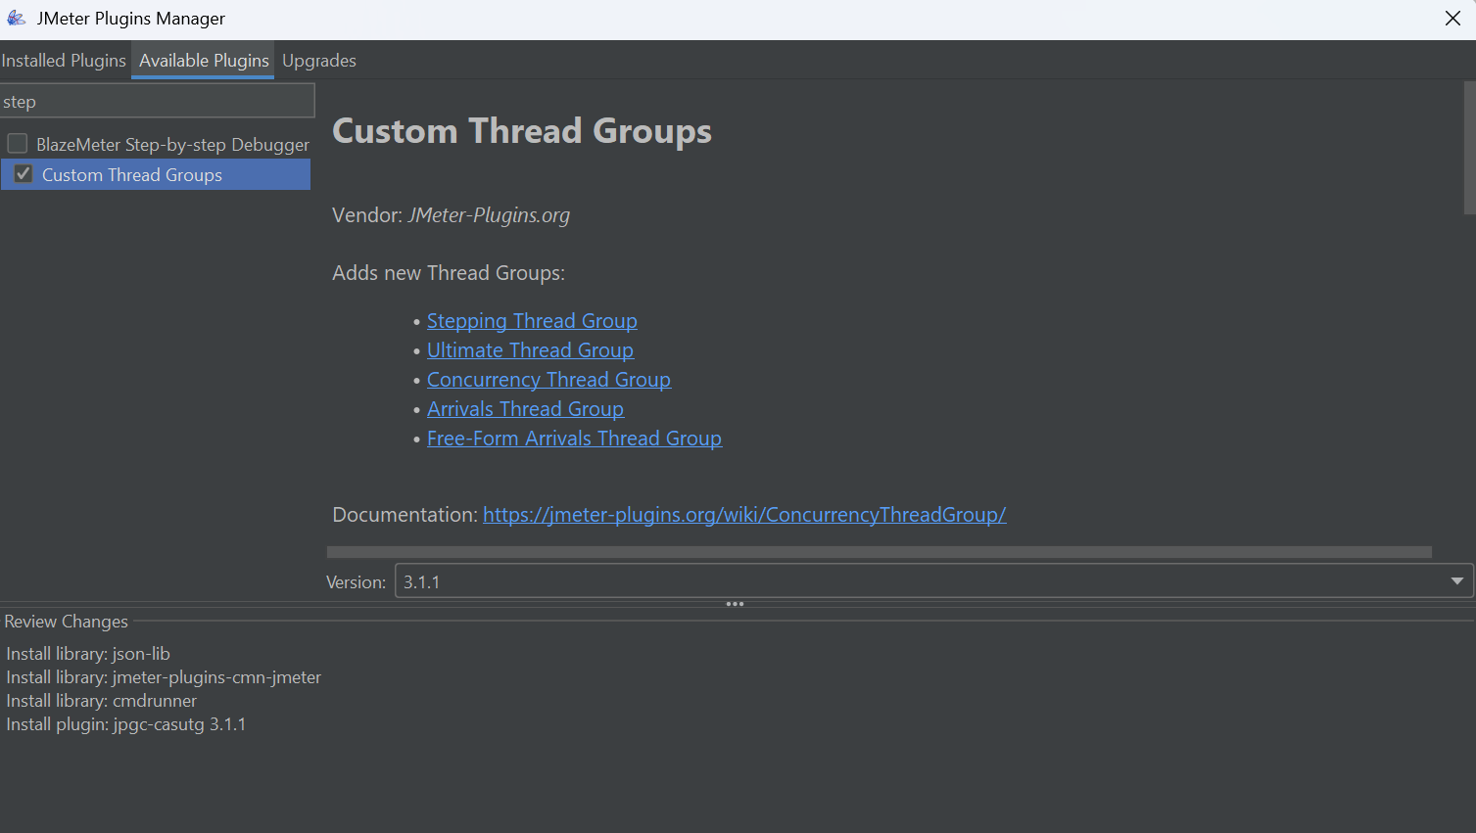


Stepping Thread Group

Slide 107
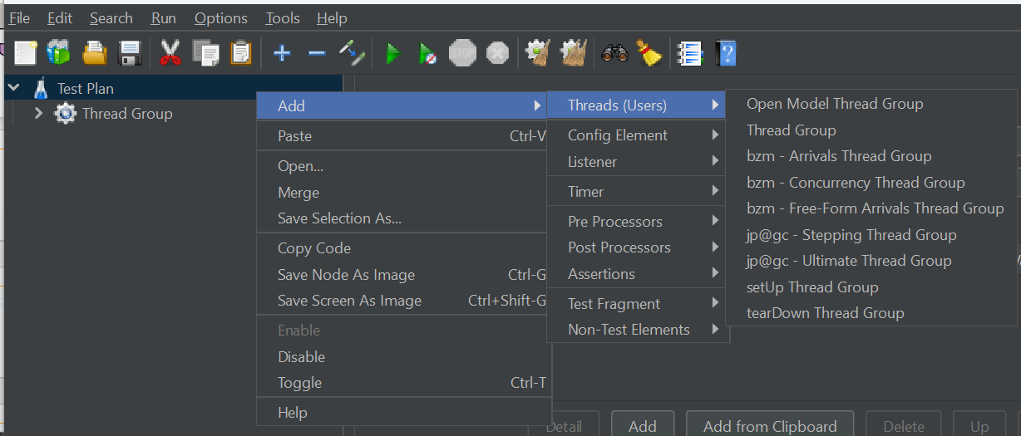
Stepping Thread Group

Slide 108
Use case for Stepping Thread Group
You are testing an e-commerce web application that expects gradual traffic increase during a Black Friday sale. You want to:
Start with a small number of users.
Gradually add more users in steps (to simulate real-world traffic growth).
Hold the peak load for some time.
Then gradually ramp down users (as traffic decreases after peak hours).

Slide 109
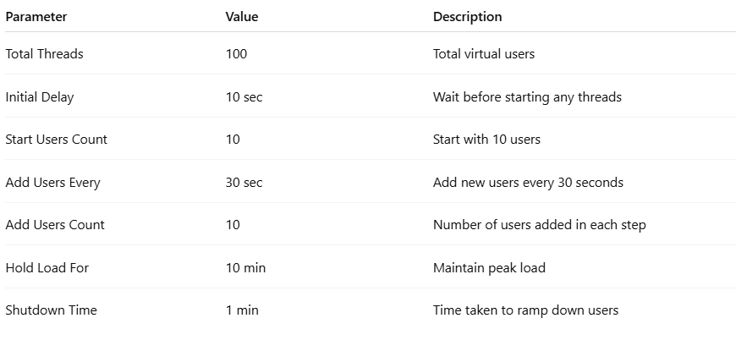
Configuration Example in Stepping Thread Group

Slide 110
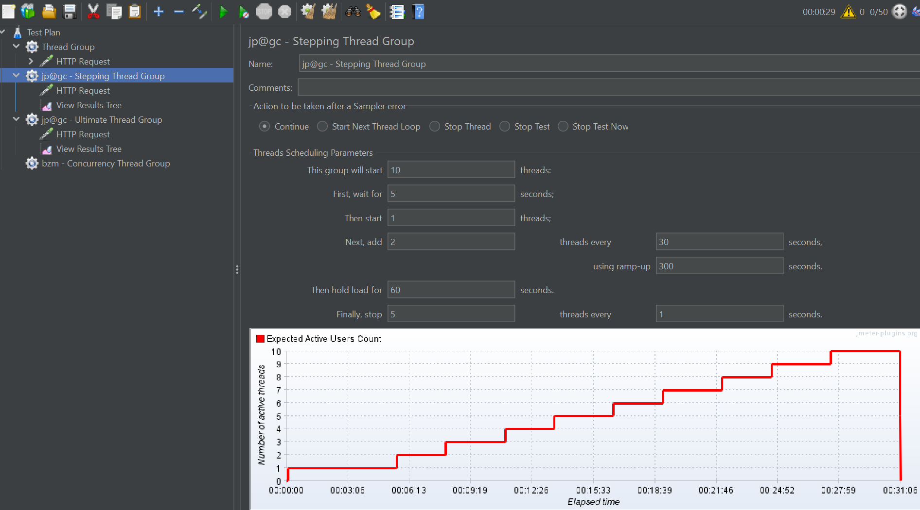

Stepping Thread Group
Total count

Slide 111
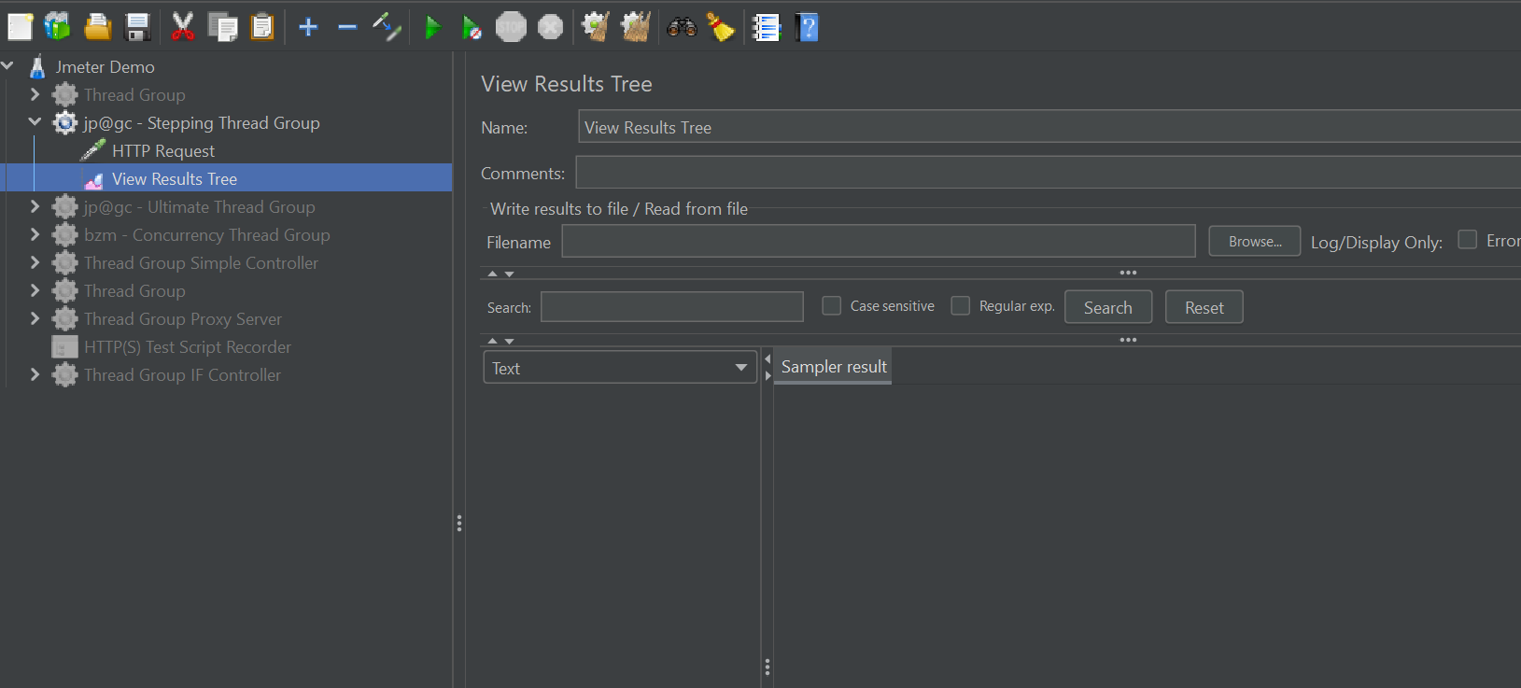
To Check Exact Count Disable Other TG

Slide 112
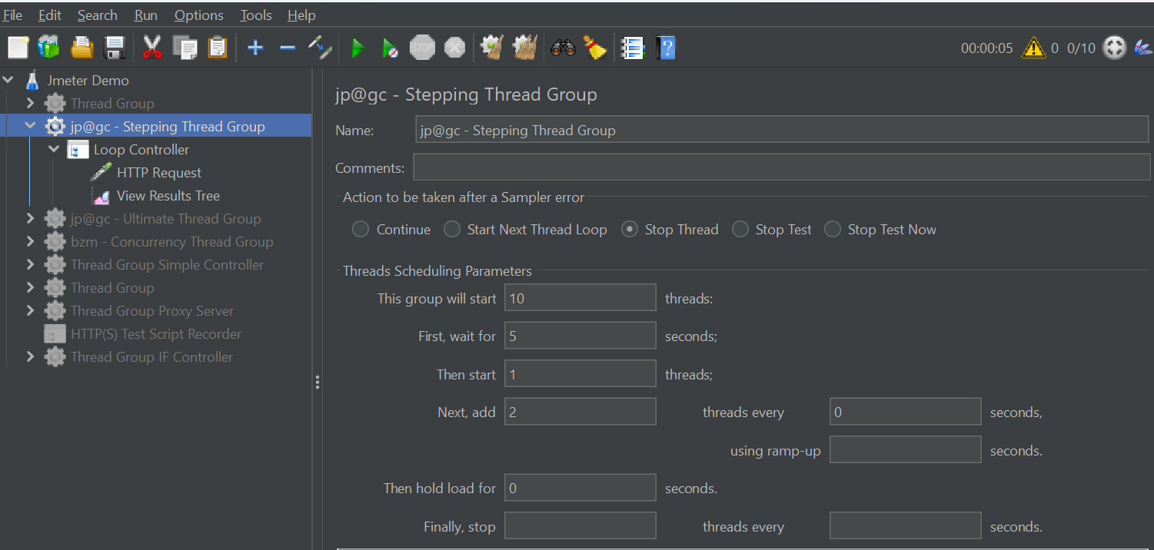

To Check Exact Count Disable Other TG
Keep 0 only to make exact requests

Slide 113
Benefits of Stepping Thread Group
Prevents server overload by avoiding sudden spikes.
Helps identify the breaking point of the application under load.
More realistic traffic simulation than standard Thread Group.
Helps monitor resource usage trends (CPU, memory, etc.) during ramp-up.

Slide 114
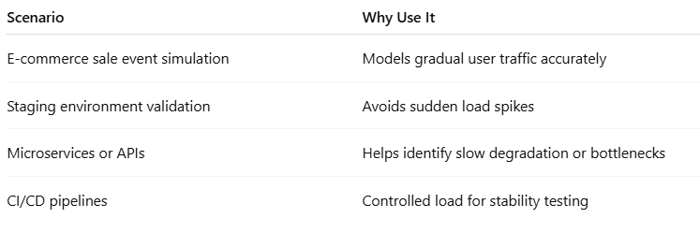
Ideal Scenarios to Use Stepping Thread Group

Slide 115
Ultimate Thread Group
The Ultimate Thread Group is a powerful and flexible plugin for Apache JMeter that allows you to define complex thread (virtual user) behavior patterns in your performance tests.
It is especially useful when you want to simulate real-world load profiles, ramp-up/down scenarios, and concurrency patterns that are not possible with the default Thread Group.

Slide 116
Features of Ultimate Thread Group
Custom ramp-up time for each thread batch.
Custom hold time (duration to maintain the load).
Precise control over thread creation in stages.
No need to script complicated thread behavior manually.

Slide 117
Use Case Example: Simulate Staggered Load
Scenario: You want to test with:
10 users starting in 5 seconds,
20 users starting in 10 seconds,
30 users starting in 15 seconds, each holding for different times.

Slide 118

Key Configuration Parameters

Slide 119
Realtime use case for ultimate thread group
1. E-commerce Flash Sale Simulation
Scenario: Simulate thousands of users logging in, browsing, and purchasing during a flash sale event.
Configuration:
Ramp-up: 1000 users over 5 minutes.
Hold time: 15 minutes.
Ramp-down: 500 users every 2 minutes.
Steps:
Login
View products
Add to cart
Checkout

Slide 120
Realtime use case for ultimate thread group
2. Banking Application Peak Load
Scenario: Test simultaneous logins and transactions at peak business hours.
Configuration:
Step 1: 200 users ramp-up in 2 minutes (login)
Step 2: 150 users ramp-up in 3 minutes (fund transfer)
Hold for 20 minutes
Step 3: Gradual ramp-down

Slide 121
Realtime use case for ultimate thread group
3. Healthcare System Load Test during Appointments Window
Scenario: Simulate patients booking appointments when booking opens.
Configuration:
500 users instantly at 9 AM (sudden ramp-up).
Hold for 10 minutes (booking activity).
Users browse doctors, select timeslot, confirm appointment.

Slide 122
Realtime use case for ultimate thread group
4. Mobile App Backend Load Test
Scenario: 24x7 usage with different peak and off-peak traffic windows.
Configuration:
Multiple UTG (Ultimate Thread Group) schedules
9AM–11AM: 500 users
1PM–2PM: 1000 users
8PM–10PM: 800 users
Each schedule has:
Staggered ramp-up
Hold period
Graceful ramp-down

Slide 123

Key Configuration Parameters

Slide 124

Key Configuration Parameters

Slide 125

Key Configuration Parameters

Slide 126

UTG

Slide 127

Key Configuration Parameters

Slide 128

Ultimate Thread Group

Slide 129
Concurrency Thread Group
The Concurrency Thread Group (CTG) is a powerful replacement for the standard Thread Group, allowing you to define:
Target concurrency (active virtual users),
Ramp-up time, and
Hold duration
It’s more intuitive and realistic for simulating modern load profiles, especially when you want to control the number of concurrent users instead of thread counts only.

Slide 130


Concurrency Thread Group

Slide 131

Concurrency Thread Group

Slide 132
How to Add Concurrency Thread Group
Open JMeter.
Right-click on Test Plan → Add → Threads (Users) → Concurrency Thread Group.
If not present, install from Plugins Manager (JMeter Plugins → Custom Thread Groups).

Slide 133

Key Configuration Parameters

Slide 134

Example Configuration

Slide 135
Example Configuration
Effect:
100 users will be injected in 5 stages (20 users every 12 seconds).
All 100 users remain active for 5 minutes.
Then all threads will shut down gracefully.

Slide 136
Use Case: API Load Testing with Realistic User Simulation
API SLA Validation
Scenario: Validate that 200 users hitting the /orders endpoint still get responses under 500ms.
Why CTG?
Maintains exactly 200 active users
Easy to measure percentile response times
Consistent throughput
Settings:
Target concurrency: 200 users
Ramp-up: 5 minutes
Hold: 30 minutes

Slide 137
Use Case: API Load Testing with Realistic User Simulation
Banking App - Fund Transfer Stability Test
Scenario: Simulate 150 users transferring funds concurrently without degradation.
Why CTG?
Simulates precise concurrency (real-world use)
Tests DB and transaction consistency
Settings:
Concurrency: 150
Ramp-up: 2 minutes
Hold: 20 minutes
Transaction delay: 3-5 sec (using timer)

Slide 138
Use Case: API Load Testing with Realistic User Simulation
Healthcare App - Doctor Booking Concurrency Test
Scenario: Ensure backend handles 300 users concurrently booking appointments.
Why CTG?
Tests backend locking, slot availability under concurrent pressure
Settings:
Concurrency: 300
Ramp-up: 3 minutes
Hold: 10 minutes
Think time: Random between 1–3 seconds

Slide 139
Use Case: API Load Testing with Realistic User Simulation
E-commerce Cart Checkout Load Test
Scenario: Validate cart and payment services with 500 active users simultaneously.
Why CTG?
Simulates 500 real users adding to cart, placing orders, processing payments.
Settings:
Target concurrency: 500
Ramp-up: 10 minutes
Hold: 15 minutes
Use CSV data for user and product info

Slide 140
Use Case: API Load Testing with Realistic User Simulation
SaaS Product Trial Period Load
Scenario: 200 trial users constantly accessing dashboards and reports during business hours.
Why CTG?
Simulates stable usage pattern during peak office hours.
Settings:
Concurrency: 200
Ramp-up: 5 minutes
Hold: 8 hours
Use scheduler to run from 9AM–5PM

Slide 141
Use Case: API Load Testing with Realistic User Simulation
CI/CD Performance Regression
Scenario: Run nightly regression with fixed concurrency to validate that the new build doesn’t introduce latency spikes.
Why CTG?
Repeatable results with controlled user load
Perfect for baseline performance testing
Settings:
Concurrency: 100
Ramp-up: 3 minutes
Hold: 60 minutes
Integrated into Jenkins/GitLab pipeline

Slide 142

Concurrency Control Using JDBC

Slide 143




JDBC Configuration

Slide 144

JDBC Configuration

Slide 145

JDBC Configuration

Slide 146

Benefits over Standard Thread Group

Slide 147
Tips & Best Practices
Ramp-Up Matters: Never dump all threads at once—gradual ramp-up better simulates real-world traffic.
Loop vs. Duration: Use Loop Count for small, fixed-size tests; use Scheduler for sustained load over time.
Monitor Resources: Watch CPU/RAM on both JMeter and target servers; adjust thread count to avoid client-side saturation.
Distributed Testing: For very large loads, use multiple JMeter instances in server–client mode, each with its own Thread Group.

Slide 148
Controllers
Apache JMeter’s Controllers are the building blocks that define the flow and logic of your test plan.
They do not generate requests themselves (that’s the job of Samplers) but instead organize and control when and how samplers are executed.
JMeter has different types of controllers.

Slide 149

1. Logic Controller

Slide 150

Configuration Highlights

Slide 151
Simple Controller
The Simple Controller in JMeter is a logical container.
It doesn’t affect execution flow but helps you group samplers and other test elements for readability and reuse.

Slide 152


Simple Controller
Group samplers

Slide 153
Simple Controller Hands-On Exercise
Create a test plan that:
Opens the homepage of a website
Hits a login endpoint
Organizes them using a Simple Controller

Slide 154
Step-by-Step Instructions
Create a test plan that:
Opens the homepage of a website
Hits a login endpoint
Organizes them using a Simple Controller

Slide 155
Step-by-Step Instructions
Open JMeter
Start JMeter GUI (jmeter.bat or jmeter.sh).
Create a Test Plan
Right-click on Test Plan → Add → Threads (Users) → Thread Group
Set:
Number of Threads: 1
Ramp-Up Period: 1
Loop Count: 1

Slide 156
Step-by-Step Instructions
Add a Simple Controller
Right-click on Thread Group → Add → Logic
Controller → Simple Controller
Rename it to Homepage and Login

Slide 157
Step-by-Step Instructions
4. Add Samplers Under the Controller
➤ Add HTTP Request – Homepage
Right-click on Homepage and Login → Add → Sampler → HTTP Request
Name: Open Homepage
Server Name: example.com
Path: /

Slide 158
Step-by-Step Instructions
➤ Add HTTP Request – Login
Right-click on Homepage and Login → Add → Sampler → HTTP Request
Name: Login
Server Name: example.com
Path: /login
Method: POST
Add body data if needed (e.g., username/password)

Slide 159
Step-by-Step Instructions
Add a Listener to View Output
Right-click on Thread Group → Add → Listener → View Results Tree

Slide 160
Step-by-Step Instructions
6. Run the Test
Click the green Start button ▶️ In View Results Tree, verify:
Requests executed in the order you added them
Grouped under the Simple Controller (for readability)

Slide 161

Graphql Sampler

Slide 162

Graphql Sampler

Slide 163

Graphql Sampler

Slide 164
Graphql Sampler

Slide 165

Graphql Sampler

Slide 166
Loop Controller
It loops only its child elements.
It does not control the whole Thread Group — only what’s inside it.
You can nest it inside a Thread Group and even combine it with other controllers.

Slide 167

Loop Controller

Slide 168

Loop Controller

Slide 169

JMS Publisher Activemq

Slide 170

JMS Publisher Activemq

Slide 171
JMS Publisher Activemq
Field | Value
QueueConnectionFactory | ConnectionFactory
JNDI Name Request Queue | dynamicQueues/employeequeue ✅
Destination | dynamicQueues/employeequeue ✅
Use JNDI Properties File | ✅ Checked
JNDI Properties File Path | Leave blank if in /bin/

Slide 172

JMS Publisher Activemq

Slide 173

Loop Controller

Slide 174

Post url test

Slide 175

CSV Data Config

Slide 176

CSV Data Config

Slide 177

Variable Configuration

Slide 178

If Controller

Slide 179
2. Transaction Controllers
Designed to group samplers and measure total time for the group as a single transaction.
Transaction Controller
Generate Parent Sample: when enabled, creates one aggregated sample for the group, hiding individual sampler times.
Include duration of timers and pre-/post-processors: toggles whether those times are included in the transaction timing.
Use Case: Measure end-to-end performance of a user task (e.g., “Login → Search → Add to Cart → Logout”) as one metric.

Slide 180
3. Module & Include Controllers
Allow reusing pieces of test plans across multiple Thread Groups.
Module Controller
Points to another Simple Controller or module defined elsewhere in the same test plan.
Encourages modularity—define a login sequence once, then reference it multiple times.
Include Controller
Reads and runs an external JMX file at that point in the test plan.
Useful when different teams maintain separate test fragments or when test plans become large.

Slide 181
4. Recording Controller
Use JMeter Recording Controller to:
Capture user actions in a browser (e.g., login, click, navigate)
Automatically create HTTP requests in a JMeter test plan
Captures HTTP requests generated by the JMeter Proxy Recorder and stores them under this controller.
Starting point when recording real browser traffic for converting to a JMeter script.

Slide 182
Prerequisites
Ensure the following before starting:
JMeter installed
Java installed
Firefox browser (preferred for proxy setup)
JMeter HTTP(S) Test Script Recorder plugin (built-in)

Slide 183

Steps

Slide 184

Steps

Slide 185

Steps

Slide 186

Steps

Slide 187

Steps

Slide 188


Add Elements
Test Plan Level

Slide 189


Choose Record Controller

Slide 190

Proxy Server Setup

Slide 191

Certificate Upload

Slide 192

Record

Slide 193

Replay

Slide 194

5. Special Controllers

Slide 195
Throughput Controllers
The Throughput Controller allows you to:
Execute child samplers X% of the time.
Or, execute N times per total iterations.
Useful when simulating load mix (e.g., 60% login, 30% search, 10% checkout).

Slide 196

Throughput Controllers

Slide 197

Throughput Controllers

Slide 198

Throughput Controllers

Slide 199

Throughput Controllers

Slide 200

Throughput Controllers

Slide 201
Best Practices
Modularize your test plan using Simple, Module, and Include Controllers—keeps large plans maintainable.
Use Transaction Controllers for high-level business transactions but also keep individual sampler metrics for detailed analysis.
Parameterize conditional controllers (If/While) with JMeter Functions or variables to adapt flows dynamically without editing the plan.
When simulating mixed workloads, leverage Throughput Controllers to vary execution frequency across different samplers.
Keep your recorded scripts clean: move related samplers under relevant Logic Controllers, delete unneeded requests, and add proper timers.

Slide 202
Samplers
In JMeter, Samplers are the elements that generate the requests to your target server (HTTP, JDBC, JMS, etc.) and gather response data.
Every sampler you add under a Thread Group (or within a Logic Controller) will be executed according to its parent’s scheduling logic.

Slide 203
1. Http Request Sampler
Most-used sampler for web testing.
Protocol [http/https]: Select http or https.
Server Name or IP: e.g., www.example.com (no protocol).
Port Number: defaults to 80 or 443.
HTTP Request:
Method: GET, POST, PUT, DELETE, etc.
Path: URI path (e.g., /api/login).
Parameters / Body Data: form or raw payload.
Advanced:
Header Manager for custom headers (Content-Type, Authorization).
Files Upload for multipart/form-data.
Embedded Resources to fetch images/CSS automatically.

Slide 204
2. JDBC Request Sampler
Execute SQL queries against a relational database.
Variable Name for Pool: reference from a JDBC Connection Configuration.
Query Type: Select (ResultSet), Update, Callable (stored proc), etc.
SQL Query: your SQL statement.
Parameters: if using placeholders (?), map values to variables.

Slide 205
JMS Point to Point / Pub Sub Sampler
Test messaging systems (ActiveMQ, RabbitMQ, IBM MQ).
JMS Connection Factory: JNDI name or Connection Configuration reference.
Destination: queue or topic name.
Use non-persistent / persistent delivery, selectors, and message payload.
Receive Timeout for synchronous consumers.

Slide 206
4. TCP Sampler
Send raw TCP requests.
Server IP / Port
Timeouts
Text to Send: raw payload (e.g., custom protocol frames).
Re-use Connection and Close Connection options.

Slide 207
5. SOAP/XML-RPC Request
Invoke SOAP-based web services.
URL: endpoint WSDL address.
SOAPAction: HTTP header for the action.
XML Data: your full SOAP envelope.
WSDL Validation and Response Assertion support.

Slide 208
6. Java Request & JUnit Request
Run custom Java code or JUnit test classes.
Classname: implement JMeter’s JavaSamplerClient.
Parameters: pass arguments to your code.
JUnit: specify Test Class, Test Method, and Classpath.

Slide 209
7. Other Notable Samplers
OS Process: run shell commands and capture stdout/stderr.
BeanShell / JSR223 Sampler: scriptable requests in BeanShell, Groovy, etc.
SMTP Sampler: send emails via SMTP server.
LDAP Extended Request: test directory services.
MongoDB Source (via Plugins), WebSocket Sampler, MQTT Publisher/Subscribers (via plugins).

Slide 210
Key Tips & Best Practices
Use Configuration Elements (HTTP Header Manager, JDBC Connection Configuration, JMS Config) to centralize common settings.
Name Samplers Clearly—include method, endpoint, or query description to make result logs readable.
Avoid Hard-Coding payloads; parameterize with CSV Data Set Config or User Defined Variables.
Validate Responses with Assertions (Response Code, JSON/XML Assertion) immediately under each sampler.
Grouping & Timing: combine with Controllers and Timers (Constant Throughput, Gaussian Random Timer) to simulate realistic traffic.

Slide 211
Listeners
In JMeter, Listeners collect, aggregate, and present the results of your test execution.
We can attach them at the Test Plan, Thread Group, or Controller level.
While powerful for debugging and reporting but many Listeners are resource-intensive—avoid using GUI Listeners in large or headless test runs.

Slide 212
1. GUI-Only Debugging Listeners
1.1 View Results Tree
Purpose: Shows every request and full response (headers & body).
Key Settings:
Scope: Attach directly under the sampler or controller you’re troubleshooting.
Sampler Result → Show Response Data: toggle between Text, HTML, JSON, XML renderers.
Use Cases:
Verifying payloads, cookies, redirects.
Inspecting failure details (assertion errors, server-side stack traces).
Gotcha: Even a few hundred samples will exhaust JVM heap—remove before large tests.

Slide 213
1. GUI-Only Debugging Listeners
1.2 View Results in Table
Purpose: Tabular view of each sample’s metrics.
Configurable Columns: Timestamp, Label, Response Code, Latency, Connect Time, Size, Success, etc.
Use Cases: Quick scrollable list of pass/fail status when debugging loops or conditionals.

Slide 214

1. GUI-Only Debugging Listeners

Slide 215

1. GUI-Only Debugging Listeners

Slide 216

1. GUI-Only Debugging Listeners

Slide 217
GUI-Only Debugging Listeners
1. Latest Sample
In View Results Table, each row is an individual sample.
The last row in this table shows the most recent (latest) request execution.

Slide 218
GUI-Only Debugging Listeners
2. Number of Samples
In the Summary Report, under the # Samples column:
Shows the total number of requests (samples) sent for each sampler (HTTP request, JDBC request, etc.)
Helps gauge the concurrency and test load.

Slide 219
GUI-Only Debugging Listeners
3. Deviation
Found in Summary Report under Deviation column.
It represents the standard deviation of the response times for that sampler.
Indicates variability in performance:
Low deviation → consistent performance
High deviation → performance is inconsistent

Slide 220
1. GUI-Only Debugging Listeners
What Is Standard Deviation (Std.Dev or Deviation)?
📉 It tells you how consistent your response times are.
Low deviation = response times are consistent
High deviation = response times vary a lot
If all 10 requests took ~200ms:
Deviation ≈ 0–10ms (very stable)
If some took 100ms and others 500ms:
Deviation could be 150–200ms (unstable)

Slide 221




GUI-Only Debugging Listeners

Slide 222

GUI-Only Debugging Listeners

Slide 223
2. Aggregate & Summary Listeners
Lightweight enough for moderate-sized GUI runs; can also write to file.
2.1 Summary Report
Metrics:
# Samples, Average, Min, Max, Std. Dev., Error %, Throughput (#/s), KB/sec.
When to Use:
Fast high-level health check of your test.
Ad-hoc runs in GUI or CI (paired with Simple Data Writer for non-GUI).
Tip: Sort by Error % or Max response time to spot outliers.

Slide 224

2. Aggregate & Summary Listeners

Slide 225



2. Aggregate & Summary Listeners

Slide 226
2. Aggregate & Summary Listeners
2.2 Aggregate Report
Difference vs Summary Report: Breaks out metrics per Label rather than global.
Use Cases:
Comparing endpoints (e.g., /login vs /search).
Export to CSV for offline analysis.

Slide 227
2. Aggregate & Summary Listeners
2.3 Aggregate Graph
Visualization: Bar chart of Average/Median/90th-percentile across labels.
Limitations: Best with ≤ 10 labels; more and the chart becomes unreadable.

Slide 228
3. Time-Series & Distribution Listeners
Add these when you want to visualize trends without an external system.
3.1 Graph Results
Chart: Response time of each sample plotted in sequence.
Key Params:
Window Size (samples): how many recent points to draw.
Refresh Interval (ms).
Use: Spot spikes or “warm-up” behaviors in short runs.

Slide 229
3. Time-Series & Distribution Listeners
3.2 Response Times Over Time
Chart: Average response time in fixed intervals (granularity in ms).
Config:
Granularity: e.g., 1000 ms buckets.
Use: Visualize latency trends—ideal for seeing degradation under load.

Slide 230
3. Time-Series & Distribution Listeners
3.3 Response Time Distribution
Chart: Histogram of response times (you set bucket width).
Use: Understand percentiles (p90, p95) and identify fat-tail distributions.
3.4 Hits per Second
Chart: Throughput curve—samples per second over time.
Use: Validate that your test is generating the intended load pattern.

Slide 231
3. Time-Series & Distribution Listeners
3.5 Active Threads Over Time
Chart: Number of active threads (users) vs time.
Use: Correlate thread ramp-up/ramp-down with response behavior.

Slide 232
4. File‐Based & Headless Listeners
Essential for CI/CD and large-scale, headless tests.
4.1 Simple Data Writer
Function: Logs raw sample results to CSV or XML.
Config:
Filename (e.g., results.csv)
Configure… select only fields you need (timestamp, label, responseTime, success).
Usage (non-GUI):
bash
jmeter -n -t testplan.jmx -l results.csv
Post-Process: Feed into JMeter Dashboard Generator or external tools (Excel, Python).

Slide 233
4. File‐Based & Headless Listeners
4.2 Backend Listener
Function: Streams metrics live to time-series backends (InfluxDB, Graphite, Prometheus).
Core Settings:
Backend Implementation: e.g. org.apache.jmeter.visualizers.backend.influxdb.InfluxdbBackendListenerClient
Parameters: URL, token, bucket/org (InfluxDB v2), measurement name, summaryOnly flag.
Best Practice: Use for distributed tests—centralizes data from multiple slaves into one dashboard.

Slide 234
5. Advanced & Specialized Listeners
5.1 Mailer Visualizer
Use: Sends an email when a sampler fails.
Config: SMTP server, “To” address, subject format, failure rate threshold.
Caution: Can flood inbox during large failure spikes; best for low-volume smoke tests.
5.2 Assertion Results
What It Shows: Only assertion failures (request + assertion message).
Use: Triage functional errors without full response dump.
5.3 BeanShell / JSR223 Listener
Use: Custom post-processing—push metrics to a DB, write specialized logs, trigger external actions.
Script Languages: BeanShell, Groovy (preferred for performance).

Slide 235
6. Plugin Listeners (via JMeter Plugins Manager)
Not built-in but commonly installed for deeper insights.
PerfMon Metrics Collector: Gathers OS-level stats (CPU, RAM, disk I/O) from remote agents.
Composite Graph: Overlay multiple metrics (response time vs CPU) in one chart.
Throughput Shaping Timer Listener: Visual check of your target throughput curve.

Slide 236
7. Best Practices Summary
Avoid GUI Listeners in Load Tests. They skew CPU/RAM and bias your results.
Use File-Based or Backend Listeners for anything over a few hundred samples.
Scope Wisely: Attach heavy listeners only to the controllers or samplers you need to inspect.
Filter Saved Fields: In data writers, log only essential columns to reduce I/O overhead.
Leverage Dashboard Generator (-e -o <dir>) to get a full HTML report post-run without manual graph setup.
Combine Metrics: Use backend + Grafana (or JMeter’s HTML Dashboard) for both real-time and post-run analysis.

Slide 237
7. JMeter Timers
JMeter Timers pause threads between sampler executions to simulate realistic “think time” and pacing.
Unlike controllers, which control flow, timers insert delays.
By default, a timer applies its delay to all samplers in the same scope (e.g., under the same controller or Thread Group) unless you scope it more narrowly.
Below is an in-depth look at the key built-in timers, configuration options, and best practices for pacing your load tests.

Slide 238

1. Core Built-In Timers

Slide 239
1. Core Built-In Timers
1.1 Constant Timer
Delay Thread: milliseconds to pause before each sampler.
Use Case: Simple think-time simulation (e.g., 500 ms between requests).
Scope: Placed under a controller or at Thread Group level to affect all children.

Slide 240
1. Core Built-In Timers
1.2 Uniform Random Timer
Constant Delay Offset: base delay in ms.
Random Delay Maximum: additional random delay up to this ms.
Resulting Delay: uniform between offset and offset + max.
Use Case: Vary delays evenly (e.g., simulate ≈1 s ± 500 ms).

Slide 241
1. Core Built-In Timers
1.3 Gaussian Random Timer
Constant Delay Offset: base ms.
Deviation (Std Dev): ms for Gaussian distribution.
Resulting Delay: offset + gaussian(μ=0,σ=deviation).
Use Case: More natural “bell-curve” variation; occasional longer/shorter waits.

Slide 242
2. Throughput-Control Timers
2.1 Constant Throughput Timer
Target Throughput: samples per minute (SPM).
Calculate Throughput Based On: All active threads or current thread only.
Mode:
This Thread Only – each thread tries to hit the target independently.
All Active Threads in Thread Group – collective throttling.
Use Case: Limit load to a steady rate (e.g., 120 requests/min).

Slide 243
2. Throughput-Control Timers
2.2 Precise Throughput Timer (Plugin)
Via JMeter Plugins Manager → install “Throughput Shaping Timer” / “Precise Throughput Timer”.
Allows:
Specifying a throughput schedule (time windows with different rates).
More accurate pacing than Constant Throughput Timer.
Use Case: Real-world traffic curves (ramp-up, peak, ramp-down phases).

Slide 244
3. Synchronization & Burst Timers
3.1 Synchronizing Timer
Number of Simultaneous Users to Group By: threads wait until this many reach the timer.
Timeout (ms): optional maximum wait.
Behavior: All waiting threads release together, creating a “spike”.
Use Case: Stress-test concurrency limits (e.g., 50 users all logging in at once).

Slide 245
4. Advanced & Plugin Timers
Test Action Sampler (under “Timers” category)
Can pause a thread, stop a thread/test; supports millisecond delays.
Use for precise control where a true “sampler” is desired rather than a timer.
BSF / JSR223 Timer
Write custom delay logic in Beanshell, Groovy, or other supported languages.
Example: dynamic delays based on response data or external data source.
Poisson Random Timer (Plugin)
Follows Poisson distribution for inter-arrival times—realistic for many systems.
Requires “Extras with Libs” plugin pack.

Slide 246
6. Best Practices
Simulate Realistic Think-Time
Base delays on real user behavior (e.g., web analytics).
Mix Constant and Random timers to avoid uniform traffic patterns.
Use Throughput Timers for Pacing
Prefer Constant Throughput Timer or Precise Throughput Timer over manually calculated delays if you need exact request rates.
Avoid Timer Overlap
Keep one timer per scope whenever possible; overlapping timers can make debugging difficult.

Slide 247
6. Best Practices
Combine with Controllers
Scope timers under specific logic controllers (e.g., under a login flow only) to model different pacing per user journey.
Leverage Plugins for Sophistication
Install JMeter Plugins for Poisson timers, throughput shaping, and advanced distributions to better mimic production traffic.
Validate Thread Delays
Use a View Results in Table listener during debugging to confirm that delays are being applied as expected before scaling up.

Slide 248
Assertions
An Assertion lets you verify the response (or other runtime state) of a sampler against expected conditions. When an assertion fails, JMeter marks the sample as failed and (depending on your test logic) can stop the thread or the test.
Scope: Attach directly beneath a Sampler or under a Controller.
Behavior:
Hard Fail: Sample is marked failed, but execution continues (default).
Stop Thread/Test: Can optionally stop thread or entire test on failure (via Test Action or “Stop Thread on error” settings).

Slide 249
Assertions
An Assertion lets you verify the response (or other runtime state) of a sampler against expected conditions. When an assertion fails, JMeter marks the sample as failed and (depending on your test logic) can stop the thread or the test.
Scope: Attach directly beneath a Sampler or under a Controller.
Behavior:
Hard Fail: Sample is marked failed, but execution continues (default).
Stop Thread/Test: Can optionally stop thread or entire test on failure (via Test Action or “Stop Thread on error” settings).

Slide 250
2. Core Built-In Assertions
Response Assertion
Use this to check anything in the HTTP response: the response text, headers, status code, response message, request data, or even the final URL.
You define one or more patterns (plain substrings, exact matches, or regular expressions) and choose whether to treat them positively or negate the match.
It’s ideal for verifying that a page contains “Welcome, user123” or that the response code equals 200.

Slide 251

2. Core Built-In Assertions

Slide 252
2. Core Built-In Assertions
Duration Assertion
If you need to enforce performance thresholds, attach a Duration Assertion beneath your sampler and set a maximum response time in milliseconds. Any sample slower than that limit is marked as failed.
Size Assertion
This checks the total response payload size. Specify minimum and/or maximum byte values—handy for catching truncated responses or unexpectedly large payloads.

Slide 253

2. Duration Assertion in JMeter
Purpose
Ensure performance SLAs are met (e.g., response time < 2000 ms)
Catch slow responses during load tests
Add fail/pass logic based on timing

Slide 254


2. Duration Assertion in JMeter

Slide 255
2. Core Built-In Assertions
XML and HTML Assertions
The XML Assertion simply parses the response as XML and fails if it’s malformed.
The HTML Assertion does the same for HTML (using JMeter’s built-in parser).
Neither validates against a schema, but both catch invalid markup quickly.
MD5Hex Assertion
JMeter computes the MD5 checksum of the response body and compares it to the value you supply.
Use this when you need to confirm that the entire payload matches exactly (for example, static file downloads).

Slide 256
Data-Format and Protocol-Specific Checks
JSON Assertion Validate JSON by writing JSONPath expressions and expected values. For instance, verify that $.success equals true or that an array at $.items contains at least one element.
XPath Assertion Target XML or HTML using XPath. Extract an element or attribute and apply substring or regex matching.
Boundary Assertion Ensure the response begins or ends with a specific string—useful for custom protocols where you expect certain framing markers.
SOAP/XML-RPC Assertion Specifically built for SOAP calls: check for a SOAP fault or that particular nodes exist in the envelope.
JDBC Assertion After a database query sampler, verify database state by running another SQL statement and applying numeric conditions (e.g., row count greater than zero).

Slide 257

Scriptable Assertions for Complex Logic

Slide 258

Compare Assertion

Slide 259

Compare Assertion

Slide 260

Compare Assertion

Slide 261
Best Practices for Assertions
Scope Precisely: Attach each assertion directly under the sampler or controller it validates. That avoids unintended checks on unrelated requests.
Use Positive Checks: Negative (negated) assertions can be harder to read and maintain. Whenever possible, assert what should be present.
Combine without Overlap: Multiple assertions under one sampler are logically ANDed. Keep each focused—one for response code, one for JSON content, one for timing, etc.
Measure Overhead: Complex scripts can slow your test. Do a small pilot run with and without assertions to judge their impact on throughput.
Fail Fast for Critical Flows: For essential steps (like login), consider stopping the thread on failure to avoid cascading false errors later in your script.

Slide 262
Common Scenarios
HTTP 200 Verification: Use a Response Assertion on the “Response Code” field, matching exactly “200.”
Content Check: Under the same sampler, add a second Response Assertion checking that the response text contains the expected welcome message or page title.
Latency Guardrail: Add a Duration Assertion set to, say, 500 ms so that any slow response is immediately flagged.
JSON Field Validation: Use JSON Assertion with JSONPath $.data.id to ensure that an “id” field is present and non-empty.
Database State: After an order-placement JDBC sampler, attach a JDBC Assertion that runs SELECT COUNT(*)… and fails if the result isn’t greater than zero.

Slide 263
Configuration elements
Configuration Elements in JMeter let you define and reuse settings or data for your samplers and processors, keeping your test plans clean, maintainable, and parameterized.
They don’t generate any traffic themselves, but they configure how samplers behave.

Slide 264
HTTP Request Defaults
Use this to centralize common HTTP settings so you don’t repeat server names, ports, or protocol on every HTTP Request sampler.
Key fields:
Protocol (http or https)
Server Name or IP
Port Number
Path (optional base path for all child samplers)
Behavior: Any HTTP Request sampler under the same scope inherits unspecified fields from these defaults.
Best practice: Place it directly under your Thread Group (or under a Simple Controller grouping related requests) so that all your HTTP samplers pick up the same host and port.

Slide 265
CSV Data Set Config
Ideal for parameterizing your tests with external data files (usernames, payloads, IDs, etc.).
Key fields:
Filename: path to your CSV file.
Variable Names (comma-separated): the columns you want to map.
Delimiter (usually a comma).
Recycle on EOF: whether to loop back to the top when you reach the end.
Stop thread on EOF: useful when you have exactly as many threads as data rows.
Behavior: On each iteration, it reads the next line and sets JMeter variables accordingly (${username}, ${password}, etc.).
Best practice: Use one CSV Data Set Config per distinct data file. Scope it so that only the samplers needing that data see it.

Slide 266
User Defined Variables
A quick way to define global or scoped variables without external files.
Key fields:
Name / Value pairs you enter directly in the GUI.
Behavior: Variables defined here are initialized once at test startup (for Test Plan level) or at controller entry if scoped under a controller.
Best practice: Use for constants like timeouts, default port numbers, or toggles (debugMode=true). For anything dynamic or large-scale, prefer CSV Data Set.

Slide 267
HTTP Header Manager
Allows you to specify HTTP headers (Content-Type, Authorization, custom tokens) to include with all HTTP Request samplers in its scope.
Key fields:
Name / Value pairs for header keys and values.
Behavior: Merges with any headers you explicitly set on individual samplers; scoped to child samplers.
Best practice: Use one Header Manager per logical grouping (e.g., one for JSON APIs, one for SOAP). If you need to vary headers per request, combine with User Defined Variables or CSV Data Set Config.

Slide 268
Cookie Manager
Emulates a real browser’s cookie handling, storing and sending cookies between requests.
Key options:
Clear cookies each iteration (uncheck for session-based flows)
Cookie policy (standard RFC, Netscape, etc.)
Behavior: Automatically captures Set-Cookie headers and includes proper Cookie headers on subsequent HTTP requests in its scope.
Best practice: Always include a Cookie Manager when testing any flow that requires session or login state.

Slide 269
Cache Manager
Simulates browser caching by honoring HTTP caching headers (Expires, ETag) and can serve cached content instead of re-fetching.
Key options:
Clear cache each iteration (uncheck if testing continuous user sessions)
Behavior: On each request, checks response headers and decides whether to send an If-Modified-Since or If-None-Match header, or serve from local cache.
Best practice: Use this when measuring realistic load—real browsers don’t fetch the same static asset for every page view.

Slide 270
Authorization Manager
Centralizes HTTP authentication credentials (Basic, Digest, NTLM).
Key fields:
Base URL (optional scope)
Username / Password
Domain / Realm (for NTLM or digest)
Behavior: JMeter automatically adds the appropriate Authorization header for any HTTP Request samplers matching the URL (or all, if no URL is specified).
Best practice: Group related URL patterns under the same Authorization Manager. If you have multiple secured endpoints with different credentials, define multiple entries.

Slide 271
JDBC Connection Configuration
Defines your database connection once so multiple JDBC Request samplers can reuse it.
Key fields:
Variable Name for the pool (e.g., myPool)
Database URL (JDBC URL)
JDBC Driver Class
Username / Password
Max Number of Connections (pool size)
Behavior: Creates and manages a connection pool that JDBC Request samplers reference via the Variable Name.
Best practice: Place this at the start of your Thread Group; avoid creating new pools in loops. Tune pool size to match your load threads.

Slide 272
Login Config Element
Provides basic form-based authentication data for HTTP samplers, automatically sending username/password to login pages.
Key fields:
Username / Password
Realm (optional)
URL (where to send credentials)
Behavior: JMeter handles the session creation for you. Note that this is older and less flexible than using a CSV Data Set + HTTP Requests to replicate complex login flows.
Best practice: Reserve for simple basic-auth scenarios. For modern OAuth or token-based logins, script the flow explicitly with HTTP samplers and extract tokens via Post-Processors.

Slide 273
BeanShell / JSR223 PreProcessor (as Configuration)
Though technically a PreProcessor, you can use these scripting elements under the “Config Element” category to set up dynamic variables or logic before samplers run.
Use cases:
Read an external properties file and set JMeter variables.
Compute a timestamp, hash, or HMAC for authentication headers.
Best practice: Prefer JSR223 with Groovy for performance; cache expensive resources outside the sampler loop.

Slide 274

BeanShell / JSR223 PreProcessor (as Configuration)

Slide 275

BeanShell / JSR223 PreProcessor (as Configuration)

Slide 276
Tips for Working with Configuration Elements
Scope Thoughtfully: Place each element at the narrowest level that still covers all intended samplers—no broader.
Name Elements Clearly: Prefix with their function (e.g. “HTTP Defaults – api.example.com” or “CSV Users – login.csv”) to keep large plans navigable.
Minimize Duplication: Centralize common settings in defaults or managers; override only when necessary.
Parameterize Everything: Even URLs, payload templates, and credentials should be variables—avoid hard-coding.
Test Config Separately: When debugging a sampler, disable unrelated config elements to isolate which one is affecting your request.

Slide 277
Pre-Processor Elements
Pre-Processor Elements let you manipulate requests or test state just before a sampler executes.
They run in the order they appear, so we can chain multiple setup steps—initializing variables, modifying HTTP requests, preparing database state—right before the actual request is sent.
Here’s a deep dive into the most used built-in Pre-Processors:

Slide 278
1. User Parameters
Use this when you need to define or override JMeter variables per thread and per iteration.
Purpose: Initialize variables that change each loop or thread without external files.
How it works: You define parameter names and values, and can use JMeter functions (like ${__threadNum} or ${__counter}) to generate dynamic values.
Typical use: Assign a unique username/password combination per user iteration when you’re not using CSV Data Set Config.

Slide 279
2. HTTP URL Re-writing Modifier
URL Rewriting in JMeter is used to maintain session state (like JSESSIONID) by appending session IDs to the URL path instead of using cookies.
This is especially useful for:
Web applications that don’t support cookies
Simulating mobile/embedded clients
Applications where session ID is passed via URL (jsessionid=xyz)

Slide 280
2. HTTP URL Re-writing Modifier
Automatically appends session IDs (or other parameters) to URLs of HTTP samplers when cookies are disabled.
Purpose: Support applications that track sessions via URL parameters instead of cookies.
How it works: You specify the session parameter name (e.g., jsessionid) and JMeter scans each request URI to insert or update that parameter with the current session value.
Typical use: Legacy web apps where you’ve disabled the Cookie Manager or when testing URL-based session-tracking.

Slide 281

2. HTTP URL Re-writing Modifier

Slide 282

2. HTTP URL Re-writing Modifier

Slide 283
3. HTTP User-Parameter Modifier
Dynamically add or alter query parameters on your HTTP requests.
Purpose: Insert parameters (headers or query string params) just before the sampler runs, based on JMeter variables or functions.
How it works: You list parameter names and values; JMeter merges these into the sampler’s configured parameters at runtime.
Typical use: Toggling feature flags, adding authentication tokens you retrieved in a previous step, or inserting timestamp tokens for cache-busting.

Slide 284
4. JDBC PreProcessor
Execute SQL statements before a JDBC Request sampler or other samplers that need a particular database state.
Purpose: Prepare database state (e.g., insert test data, clean up tables) immediately before a query or update.
How it works: You reference your JDBC Connection Configuration (via its variable name), write your SQL (INSERT, DELETE, etc.), and JMeter runs it in the sampler’s thread context.
Typical use: Seed a user record before running a login sampler or reset a counter before a performance query.

Slide 285
5. BeanShell / JSR223 PreProcessor
Script any custom logic in BeanShell, Groovy (via JSR223), or other supported languages to set variables, compute signatures, or manipulate the test state.
Purpose: Handle dynamic preparations that aren’t covered by built-in elements—compute HMACs, fetch a token, read an external file, or call another service.
How it works: The script has access to JMeter APIs (vars, props, ctx, prev) and can set JMeter variables (vars.put("foo", "bar")) or alter sampler properties directly.
Typical use:
Generating a timestamped JSON Web Token (JWT) for an Authorization header.
Fetching a fresh CSRF token from a preflight request and injecting it into the next sampler.

Slide 286

5. BeanShell / JSR223 PreProcessor

Slide 287



5. BeanShell / JSR223 PreProcessor

Slide 288
6. HTML Link Parser
The HTML Link Parser is a Pre-Processor in JMeter used to automatically extract and download resources like:
Images (<img src="">)
Scripts (<script src="">)
Stylesheets (<link href="">)
Frames (<frame src=""> or <iframe src="">)
This allows JMeter to simulate a real browser, which typically loads these additional resources after fetching a webpage.

Slide 289
6. HTML Link Parser Where to Add
Right-click on your HTTP Request ➤ Add ➤ Post Processors ➤ HTML Link Parser

Slide 290
6. HTML Link Parser Where to Add
When added, the parser:
Parses the HTML response body of the HTTP Request.
Extracts links to embedded resources.
Automatically generates sub-requests for those resources.
These sub-requests are sent as part of the parent request execution.

Slide 291
6. HTML Link Parser
Simulate a request to:🔗 https://en.wikipedia.org/wiki/Main_Page…and have JMeter auto-download embedded resources (images, stylesheets, etc.) using HTML Link Parser.

Slide 292
6. HTML Link Parser
Add HTTP Request to Wikipedia
Right-click Thread Group → Add → Sampler → HTTP Request
Name: Wikipedia Main Page
Method: GET
Server Name or IP: en.wikipedia.org
Path: /wiki/Main_Page
Check ✅ Retrieve All Embedded Resources

Slide 293
6. HTML Link Parser
(Optional) Add Cookie and Cache Managers
To simulate browser behavior better:
Right-click Thread Group → Add → Config Element → HTTP Cookie Manager
Right-click Thread Group → Add → Config Element → HTTP Cache Manager

Slide 294
6. HTML Link Parser
In the View Results Tree:
The parent request will be to Main_Page.
Sub-requests will be created for:
CSS: /w/load.php?...
Images: /static/images/...
JavaScript: /w/load.php?...

Slide 295


6. HTML Link Parser

Slide 296
7. Test Action (Pause Before Sampler)
Although often classified under Samplers, Test Action can act like a PreProcessor when you want to introduce a delay or thread stop right before the next sampler.
Purpose: Control pacing or stop conditions in the middle of a flow.
How it works: You configure it for a “Pause” of X milliseconds, or a “Stop” of the thread/test immediately before the target sampler executes.
Typical use: Simulate think-time more precisely than Timers when you need to pause at a very specific point in your transaction.

Slide 297
Best Practices for Pre-Processors
Order Matters: They execute sequentially. Group related setup steps together and order them so that each builds on the last.
Scope Narrowly: Place PreProcessors under the smallest controller (or directly under the sampler) that needs them to avoid unintended modifications elsewhere.
Minimize Overhead: Keep scripts lean—JSR223 + Groovy is far faster than BeanShell. Cache any expensive resources (like HTTP clients) globally via props if possible.
Use Variables, Not Hard-Code: Always write values back to JMeter variables (vars.put) so downstream samplers can reference them.
Clean Up After Yourself: If you insert database rows with a JDBC PreProcessor, consider a matching PostProcessor or TearDown Thread Group to delete test data, keeping your environment tidy.

Slide 298
Post-Processor Elements
Post-Processors in JMeter run after a sampler executes, letting you extract data from responses, perform clean-up, or conditionally alter test flow.
They’re essential for building dynamic, data-driven scripts—capturing tokens, parsing HTML/JSON, or writing responses to files.
Below is a deep dive into the most used built-in Post-Processor elements, when and how to apply them.

Slide 299
What Is a Post-Processor?
A Post-Processor is executed immediately after its parent sampler (or controller). It has access to the sampler’s result (prev) and can:
Extract values into JMeter variables for later use
Validate or debug responses (without marking the sampler failed)
Save parts of the response externally
Programmatically decide to continue or branch your test
Scope them directly under the sampler or controller you want to process.

Slide 300
Core Extractors
Regular Expression Extractor
Use this to pull arbitrary text using regex groups. Key steps:
Specify the field to check (Response Body, Response Headers, URL, etc.).
Enter your regular expression with one capturing group (e.g. <input name="token" value="(.+?)").
Provide a template ($1$) and default value if no match is found.
Optionally extract multiple occurrences by index (0 = random, 1 = first, -1 = last).
Common for session IDs, hidden form fields, or slicing tokens out of HTML.

Slide 301
JSON Extractor
Built for JSON APIs. You define one or more JSONPath expressions (e.g. $.data.items[0].id) and target variable names. JMeter will:
Assign the extracted value to your variable
If multiple matches, you can set Match Numbers (0 for random, -1 for all into a variable array)
Ideal for reading fields from REST responses without scripting.

Slide 302
XPath Extractor
For XML or HTML you can’t treat as JSON. Give it:
An XPath query (e.g. //book[1]/@id)
A variable name
A default if no node matches
Works well when your application returns complex XML or HTML and you need structured node access.

Slide 303
CSS/JQuery Extractor
An alternative to XPath for HTML: use CSS selectors (e.g. div.post > a.title) and an attribute to grab (text, href, etc.). It’s often simpler than XPath for web pages.

Slide 304

Scriptable Post-Processors

Slide 305


Scriptable Post-Processors

Slide 306
BeanShell / BSF PostProcessor
These let you write in BeanShell, JavaScript, or other BSF-supported languages.
They work similarly to JSR223 but are slower—reserve them only if you have existing scripts in those languages.

Slide 307
Utility Post-Processors
Debug PostProcessor
Adds all JMeter variables and properties into the sample results (viewable in “View Results Tree”). Great for troubleshooting why an extracted variable is empty or mis-scoped.
Save Responses to a File
Writes each sampler’s response (or parts of it) to disk. You configure:
Filename Prefix and Suffix
Variable Name to include in the filename
Scope of what to save (body, headers)
Handy when you need to audit responses offline or compare payloads.

Slide 308
BeanShell / JSR223 Assertion
Although technically an assertion, you can write Groovy code here to programmatically inspect the response and fail the sample or set error messages—effectively blending processing and validation.

Slide 309
Chaining Extractors and Pre-Processors
Often, we’ll combine:
A JSON Extractor to pull a token
A JSR223 PreProcessor to build an Authorization header using that token
An HTTP Sampler to call a protected endpoint
A Regular Expression Extractor on the new response

Slide 310
Best Practices
Use JSR223 + Groovy for any custom logic—fast, thread-safe, and expressive.
Scope Narrowly: place extractors directly under the sampler whose response you’re parsing.
Name Your Variables Clearly (e.g., login_token vs token) to avoid confusion in multi-step flows.
Provide Default Values: always set a default in extractors so missing data doesn’t break your script.
Debug Early: attach a Debug PostProcessor during development to confirm variables are populated.
Combine with Assertions Judiciously: extract first, then validate extracted values if needed, to separate concerns.

Slide 311

Create FTP Server

Slide 312

Create Java Sampler

Slide 313


Create Java Sampler

Slide 314

Create Java Sampler

Slide 315


Create Java Sampler

Slide 316
Graphite Tool
docker run -d --name graphite -p 72:80 -p 2003-2004:2003-2004 -p 2023-2024:2023-2024 -p 8125:8125/udp -p 8126:8126 --network qualcommnetwork graphiteapp/graphite-statsd

Slide 317

Graphite Tool Configuration

Slide 318


Graphite Tool Configuration

Slide 319

Graphite Tool Configuration

Slide 320

Graphite Tool

Slide 321

Graphite Tool

Slide 322

Graphite Tool

Slide 323

Graphite Tool Metrics

Slide 324

Graphite Tool Metrics

Slide 325

Graphite Tool Metrics

Slide 326

Graphite Tool Metrics

Slide 327

Grafana and Graphite Integration

Slide 328

Grafana and Graphite Integration

Slide 329
Why Prometheus Plugin in Jmeter
Add Prometheus Backend Listener to JMeter test plan.
JMeter pushes metrics to an HTTP endpoint (usually /metrics).
Prometheus scrapes those metrics at intervals (e.g., every 5 seconds).
Grafana queries Prometheus and visualizes metrics on dashboards.

Slide 330

Example Metrics Captured

Slide 331
Use cases
Load testing microservices and visualizing API performance
Stress testing to identify system breaking points
Live performance dashboards for stakeholders
Performance trending over time in CI/CD

Slide 332

Prometheus Plugin
Add Prometheus plugin
https://github.com/johrstrom/jmeter-prometheus-plugin/releases

Slide 333


Prometheus Dummy Sampler
Install it from available plugins

Slide 334

Prometheus Dummy Sampler

Slide 335

Prometheus Dummy Sampler

Slide 336

Prometheus Dummy Sampler

Slide 337

Prometheus Dummy Sampler
Service Running in windows
Still use host.docker.internal

Slide 338

Prometheus Dummy Sampler

Slide 339

Test Fragment(Reusability)

Slide 340

Module Controller

Slide 341

Module Controller

Slide 342

Passing JWT Token

Slide 343

Passing JWT Token

Slide 344
Questions

Slide 345
Module Summary
In this module we discussed
Overview of Maven
Maven archetypes
Maven life cycle phases
The pom.xml file
Creation of Java projects using Maven
Creation of war files

